Slide 1
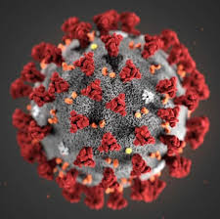

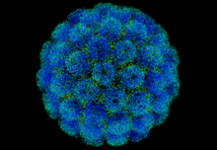
the COVID-19 Vaccines: where are we & where are we going?
The AZPHA Morning Riff
October 23, 2020
Will Humble, MPH
Arizona Public Health Association

Slide 2
Objectives
Understand the types of SARS CoV2 vaccines under development
Become familiar with the FDA approval processes for vaccines
Learn about what the National Academies of Medicine is recommending regarding prioritizing early vaccine
Form a better understanding of effective policy decisions that will lead to more rapidly achieving herd immunity

Slide 3
The Herd Effect
(and how to get there)
Herd Effect
Threshold
Amount of Immunity
Needed
Natural
15%
65%
Vaccine Induced
50%
Vaccine Effectiveness
X
Vaccine
Coverage
Vaccine Effectiveness
70%
Vaccine Coverage
70%
X

Slide 4
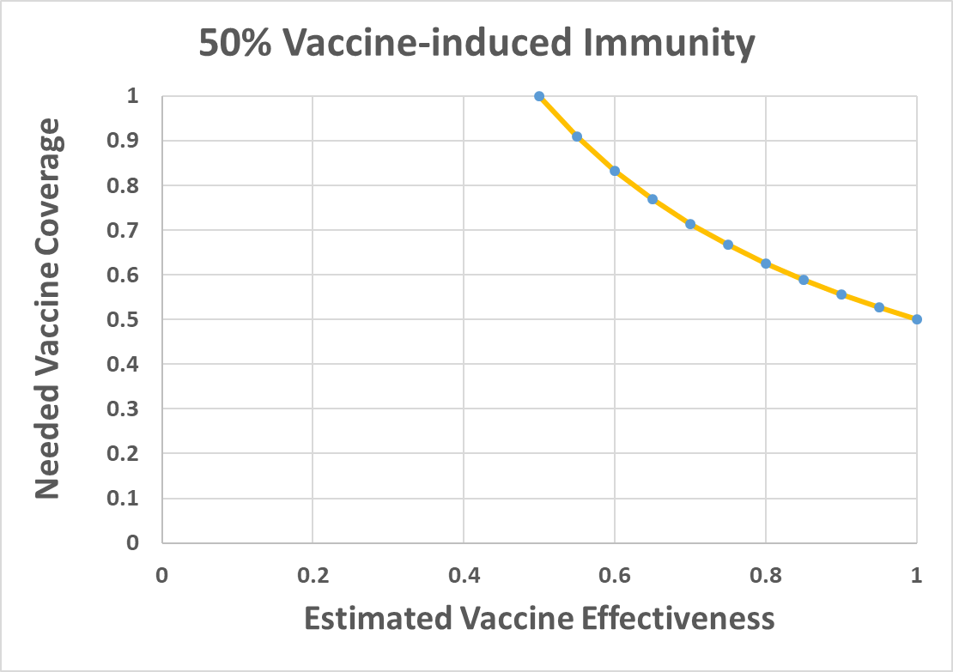

Slide 5
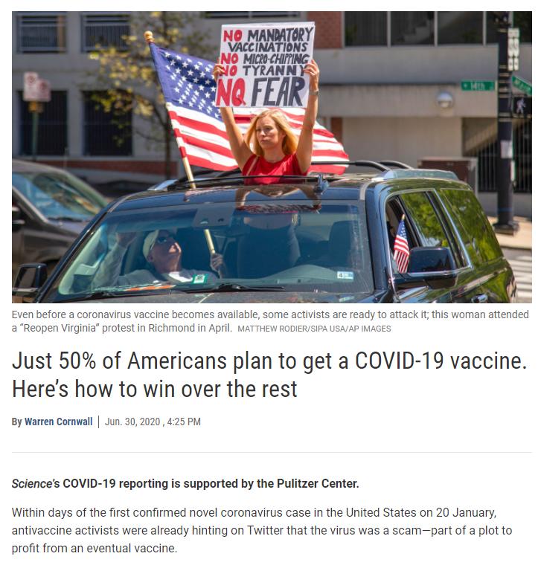
https://www.sciencemag.org/news/2020/06/just-50-americans-plan-get-covid-19-vaccine-here-s-how-win-over-rest

Slide 6
Events in vaccine development
Identification of
Candidate Disease
Application to FDA
Laboratory isolation
of antigens
Human Testing
For Safety
And Response
Vaccine
Development
Animal Testing
For Safety
And Response

Slide 7
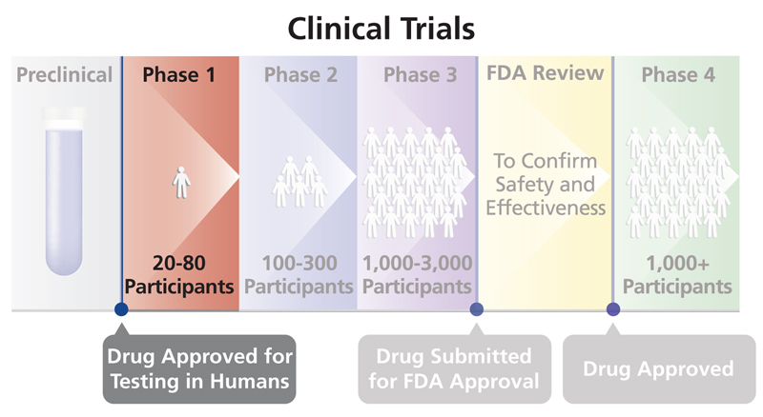
Phases of clinical trials

Slide 8
Phases of clinical trials
Phase 1: clinical trials focus on safety
  20–100 healthy volunteers
  Assesses how the size of the dose may be related to side effects
  Serological effects
Phase 2: clinical trials assess dosing
  several hundred volunteers
  additional information on common short-term side effects and how the size of the dose relates to immune response
Phase 3: clinical trials assess efficacy and safety
  Participation of hundreds or thousands of volunteers (30,000 for SARS CoV2)
  Placebo-controlled RCTs

Slide 9
Initial Safety assessments
Ongoing Safety Assessments
Review
Adjudication
Analytics
Recruitment
21-28 days
42 days
Dose 1
Dose 2
Initial Safety Assessments
initial safety assessment occurs > 63—70 days after the last participant in a trial receives the first dose

Slide 10
Federal Government vaccine efforts
Federal public-private collaboration between
  Vaccine manufacturers, Department of Defense
  Biomedical Advance Research and Development Authority (BARDA)
  Centers for Disease Control and Prevention (CDC)
  Food and Drug Agency (FDA)
FDA Commissioner has ultimate authority to assure safety & efficacy
Feds funding the manufacture of vaccines during phase iii testing
Financial risk shared by companies and gov’t (mostly gov’t)
Result: vaccine available immediately after testing completed -
months earlier than the usual process

Slide 11
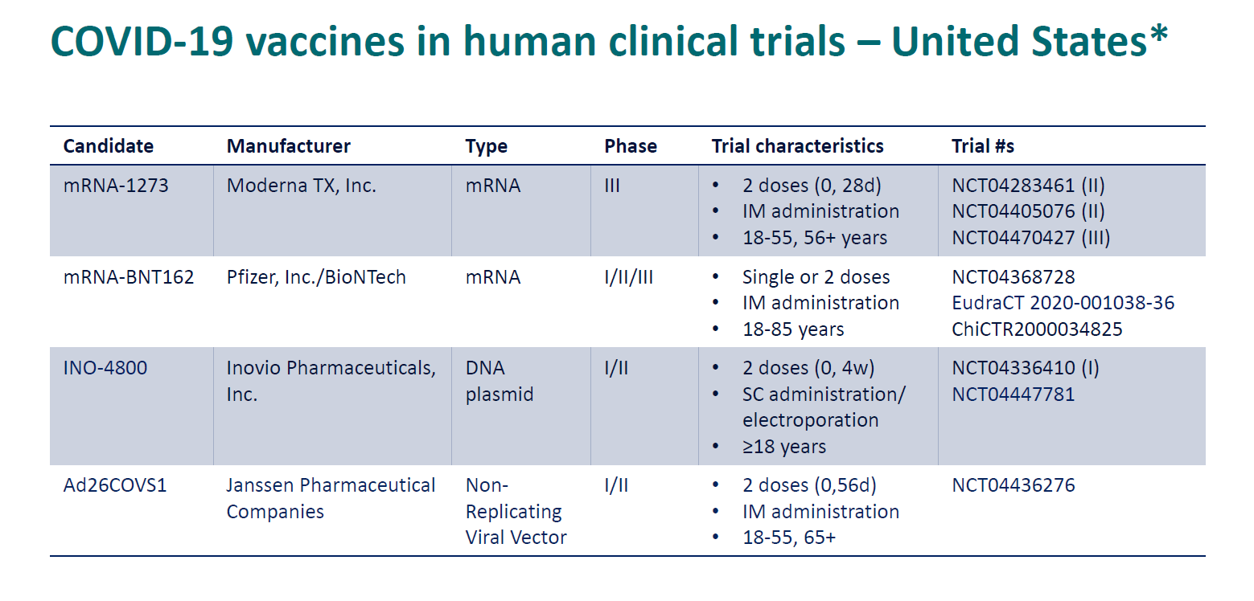
*
*

Slide 12
Vaccine | Moderna (mRNA-1273) | Pfizer/BioNTech (BNT162b2)
Dosage and Administration | 100-mcg dose, 2 IM doses given 28 days apart | 30-mcg dose, 2 IM doses given 21 days apart
Packaging | Frozen liquid 10 doses per vial No preservative | Frozen liquid 5 doses per vial No preservative Minimum 195 vials (975 doses) per shipment. Requires mixing with separately shipped diluent before administration
Storage | –20ºC (–4ºF) up to 6 months 2o-8ºC (36º-46ºF) up to 7 days 6 hours after vial punctured | Shipped directly from manufacturer on dry ice –70ºC (–94ºF) up to 6 months 2º-8ºC (36º-46ºF) up to 24 hours 2 hours at room temperature after vial thawed After mixing with diluent, discard any doses unused after 6 hours

Slide 13
Logistics of current M-RNA vaccines
Challenges
only used in research and referral clinical labs
5-10 dose vials and reconstitution → waste in low volume clinics
Solutions?
Vaccinate at centralized sites with -70ºC freezers
Work with manufacturers (Pfizer etc.) to get data on storing at -20ºC rather than -70ºC
CDC says a mobile cold chain solution exists; advises vaccinators & counties not to buy -70ºC freezers

Slide 14
Characteristics of the various vaccines
Differences
mRNA vs. virus vectored
Vastly different storage and handling requirements
Similarities
Target is spike protein
2 doses required
  need to keep with same product
Close attention to logging all doses
All are in large phase III trials
Unknowns
Differences in Safety?
Differences in Efficacy?

Slide 15
Vaccine prioritization
SARS-CoV-2 Vaccine is likely to be limited in availability
  Vaccines will be a scarce resource for many months in the U.S. & globally
  Ethical issues abound
The pandemic is likely to be ongoing with significant morbidity and mortality
  Effects will not be distributed equally
  Certain individuals and groups will be at higher risk
    Demographic
    Occupational
Unclear how federal, state and local decision-makers will prioritize early doses in the us. CDC has yet to offer guidance.
Global health equity and ethical decisions have largely been ignored by U.S. administration

Slide 16
Prioritizing the early does of vaccine
National Academy Plan for the equitable allocation of vaccine
The report part is part of a study commissioned by the NIH and CDC
Tier 1 populations include:
  1a: Front-line healthcare workers (including care home workers, hospitals, home health)
  1a: Emergency services workers
  1B: Older adults in crowded settings
  1B: Persons of all ages w/co-morbid conditions & significantly increased risk

Slide 17
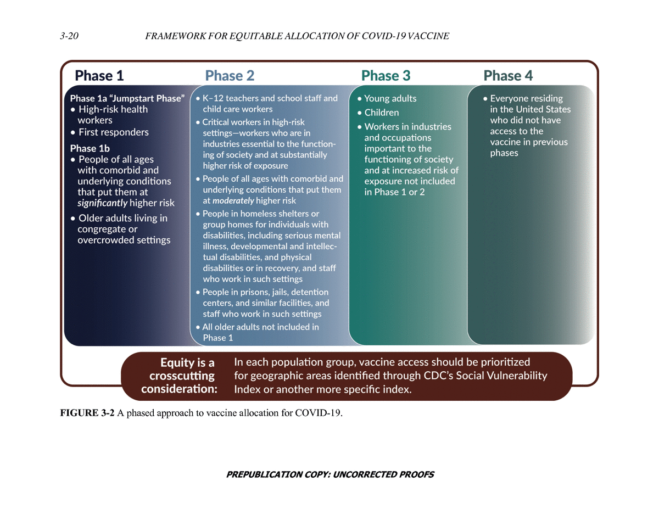

Slide 18
VACCINE Next steps (approval v. eua)
Pathway 1: Manufacturer(s) apply to the FDA for emergency use authorization (EUA)
  FDA EUA determination based on whether the vaccine(s) are likely to have more benefit than risk
  If EUA is authorized, manufacturers can begin deploying the vaccine, but mist collect and submit data
Pathway 2: Manufacturer(s) apply to the FDA for full approval
  Application reviewed by the FDA Center for Drug Evaluation and Research
  Independent committee of physicians, statisticians, chemists, pharmacologists, and other scientists
  FDA commissioner makes final approval decision
  Advisory Committee for Immunization Practices (ACIP) reviews data and makes recommendations for how to use the vaccines, which populations, scheduling etc. (has implications for reimbursement).
  ACIP recommendations include the age(s) when the vaccine should be given, the number of doses needed, the amount of time between doses, and precautions and contraindications.

Slide 19
State vaccination plan
  States develop vaccination plans for how to prioritize and deploy vaccines
  ADHS has developed a draft plan
    Process for making allocation decisions
    identify initial priority populations
    logistical decision-making regarding specific requirements for vaccine deployment
    Processes for recruiting providers
    Recommendations made to the Director by the Vaccine and Antiviral Prioritization Advisory Committee (VAPAC)
    VAPAC are “… Subject Matter Experts who are responsible for reviewing the CDC, ACIP, and NASEM, and providing guidance and providing recommendations to the director of adhs
    County health departments will make many local decisions
    Operational plans will be key to successful deployment

Slide 20
ending the pandemic
Ending the pandemic will require herd immunity
Herd Immunity is achieved through a combination of infection/recovery and vaccination
Consumer confidence that the vaccines are safe and effective are critical to achieving enough voluntary vaccination to achieve herd immunity
Consumer confidence contingent on good outcomes, especially safety
Vaccine safety is best assured by going through full FDA approval
Long term success more important than deploying the 6-8 weeks earlier and risking long-term perception that the vaccines are either unsafe or ineffective or both

Slide 21

JOIN US!
Join us at on our membership web link.
Individual memberships are only $75/year and student memberships priced at just $25/year.
We also have various Organizational Memberships.
CONTACT INFORMATION:
Arizona Public Health Association
Will Humble, M.P.H.
willhumble@azpha.org
Blog: http://www.azpha.org/wills-blog
Twitter: @willhumble_az
@PublicHealthAZ

