Slide 1



Key Policy decisions Affecting the COVID-19 Pandemic in Arizona
February 23, 2021
Will Humble, MPH
Arizona Public Health Association

Slide 2




Key Policy Decisions: March/April 2020
Early March 2020: 1st AZ Case Detected, Executive Order Signed Invoking ARS 36-787, 788, 789. public health emergency s declared
Executive Order 2020-12 Signed March 23. 2020: AKA 1st Stay at Home Order
Follow Up Stay at Home Order March 30: Added new restrictions
April 29: Stay at Home Order Extended through May 15
May 4, EO 2020-34 rapidly ends Stay at Home Order Effective 5/15
Compliance with mitigation measures strictly voluntary after May 15
Cases rapidly escalate after Memorial Day- No action taken
Cities and Counties Prohibited from Imposing Mask Mandates or other mitigation measures

Slide 3

Key Policy Decisions: May/June
Cases and hospitalizations rapidly escalate in early June. No action taken.
Cities and Counties still prohibited from Imposing Mask Mandates or other Mitigation Measures
Late June, Hospitals Fill. Cases escalate exponentially.
Testing improves but w/o increasing analytic capacity (operation catapult)
Results in turn-around times of 14 days plus undermine contact tracing
Governor lifts prohibition on cities/counties imposing mask mandates (6/17)
Many Cities and Counties rapidly impose mask mandates
Cities and Counties still prohibited from imposing other mitigation measures
As hospitals fill, Governor imposes “Pause on Operation of Bars, Nightclubs. Restaurants become take-out only (June 23)

Slide 4
Key Policy Decisions: June/July/August
Cases and hospitalizations rapidly escalate in early July
Arizona becomes national and global hotspot for covid transmission
Bars and Nightclubs Stay Closed in July. Restaurants take-out only.
Cases and hospitalizations drop significantly. Cases drop more than 75% in 6 weeks through August 6
“Pause” is lifted on August 6. Bars, Nightclubs allowed to open with a signed Attestation. Restaurants go in-person dining w/attestation
Attestations not enforced. Complaint hotline opens but with little actual enforcement of attestation requirements
Testing finally improves with $2M Sonora Quest ‘grant’

Slide 5
Key Policy Decisions: Sept/Oct/Nov
Cases increase (linear) through September
Advocates encourage ADHS to establish metrics for when to open schools for Fall semester
Executive order requires ADHS to develop school Standards. Good guidance is developed: governing boards decide
Business metrics established to drive opening and Operation of bars, restaurants and nightclubs
Slow Increase in Cases continues in September and October. Becomes exponential in November
Virtually no enforcement of the required mitigation measures occurs in the fall
15 enforcement actions among tens of thousands of bars and nightclubs and restaurants!

Slide 6
Key Policy Decisions: Nov/Dec
Cases go exponential in November, hospitalizations for COVID increase dramatically
Very little enforcement in bars, restaurants, nightclubs (still)
Local face covering ordinances mostly in place but hardly enforced
Mask mandates remain individual, not business focused
Cities counties still prohibited from taking mitigation action
CMOs & others urge mitigation measures in bars, nightclubs, restaurants
Pleas are ignored by Governor Ducey and Director Christ

Slide 7
Key Policy Decisions: Nov/dec
Cases continue exponential growth in December
Hospital admissions dominated by COVID patients
Non-emergency Procedures Canceled
Contingency standards of care implemented
  Primary Secondary and Tertiary Triage etc.
Continued pleas to intervene ignored
Pfizer vaccine given EUA December 14. Doses arrive 2 days later.
Category 1a vaccination begins
Moderna given EUA 12/21
Appointment making software defective, greatly slowing appointments

Slide 8

Key Policy Decisions: January/February
No discussion of mitigation in spreading environments is considered
Vaccine appointments must go through state website
ADHS vaccination appointment website frustrates seniors
As AZ lags in vaccine distribution ADHS/Governor partner with BCBSAZ & others to set up ‘State POD’ at Cardinal’s stadium
ADHS prioritizes vaccine to supply state site, impeding county vaccine supplies
Appointments released in “bolus” bursts, disadvantaging working families
Despite calls to make the ADHS appointment fair, changes not made

Slide 9
Key Policy Decisions: January/February
Journalists & advocates ask for demographic and Zip Code distribution of vaccinations
MCDPH releases Zip Code distribution
ADHS still has not released zip code distribution maps Maps show clear health disparities in vaccine administration
Low-income Zip Codes in 30-40% range (of eligible persons)
High-income Zip Codes at or over 100% (of eligible persons)
No state interventions planned to improve ADHS appointment website to help low- income families
Vaccine supply continues to favor state sites over county allocations
Federal pharmacy / FQHC program implemented

Slide 10
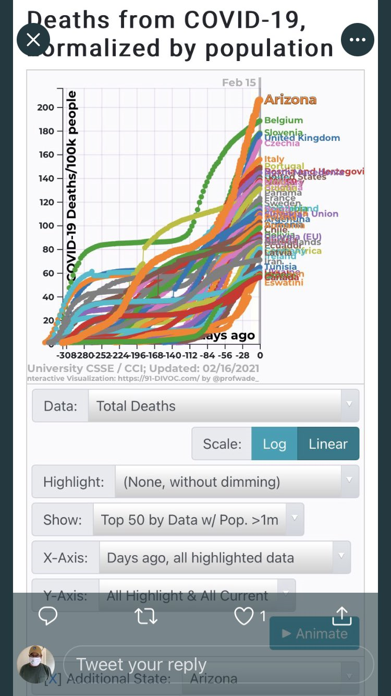

Slide 11

JOIN US!
Join us at on our membership web link.
Individual memberships are only $75/year and student memberships priced at just $25/year.
We also have various Organizational Memberships.
CONTACT INFORMATION:
Arizona Public Health Association
Will Humble, M.P.H.
willhumble@azpha.org
Blog: http://www.azpha.org/wills-blog
Twitter: @willhumble_az
@PublicHealthAZ

