Slide 1
Improving Health At a Time of Change and Uncertainty
John Auerbach
President and CEO
March 30, 2017

Slide 2

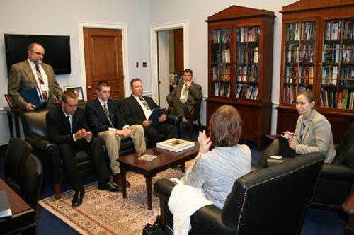
About TFAH: Who We Are
Translate existing data & research
Build support for strong public health system
Produce strategic policy reports
Conduct targeted communications & educate policymakers
Support non-partisan advocacy
Notes:
● Translating existing health-related data and research: TFAH understands the significance of research, interprets it quickly, and disseminates it among diverse audiences, making it urgent, a priority. TFAH is a real boundary spanner.”
● Building consensus for a stronger public health system: TFAH holds meetings and forums where diverse stakeholders convene to discuss the best evidence available. The aim is to define a science-based policy framework for a modern, effective, well- funded and accountable public health system with a broad, multi-sectoral base of support. TFAH partners with a range of public health organizations, and also works with health care providers, philanthropy, and community-based organizations, such as the YMCA, and reaches out to nontraditional partners, in sectors ranging from education to business to labor unions.
● Producing strategic policy reports: TFAH produces reports that focus attention on important public health issues, from emergency preparedness and obesity, to food safety and injury prevention. Typically these reports lay out policy choices and provide recommendations.
● Conducting strategic communications and educating policymakers. TFAH makes sure that its reports, action agendas, polling and other information are disseminated to key stakeholders, including policymakers, opinion leaders, and the general public. Targeted media outreach includes issuing advisories and press releases, creating Web resource materials, conducting in-person and audio media conferences and one-on-one interviews.
● Conducting advocacy. TFAH used its findings to guide subsequent advocacy work, particularly in terms of engaging with local and state-based partners to ensure that members of Congress hear from people in their districts about the impact of investing federal resources in public health.

Slide 3

Who Am I?

Slide 4

Meet Fran Edwards:
Newly insured
At MD for first physical in 5 years
55 years old, married, smokes, overweight, little exercise
Asthmatic, pre-diabetic
Stopped taking medications in past due to cost
Notes:
But before we dive into these frameworks and tools, let’s step back for a moment and remind ourselves why being at the table matters.
Meet Fran Edwards. She has recently become insured – as has millions of other Americans. She has benefitted from increased access to care as insurance options expand and necessary clinical interventions. She can now get her medications and see a primary care provider instead of an ER doctor.
But this care is not enough to ensure that she will have optimal health now and in the future.

Slide 5
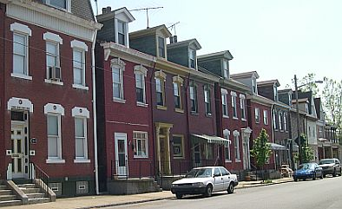
Insurance and Quality Care Help…
But they Aren’t Enough
Income - Poor, family of 5
Barriers to Fitness – Rising crime, few parks, no nearby supermarket
Under stress - Son with behavioral health concerns, worried about money
Sub-par Housing – Mold and ventilation problems
Notes:
There are other factors that have a major impact on her health.
She has a low income
There are major barriers to her fitness due to safety issues, few low cost and accessible options to exercise, and no nearby supermarket
She is under stress
And she lives in sub-par housing with mold and ventilation problems that triggers her asthma
In public health, we need to pay attention to all of the ways that we can promote good health. One way approach alone is not enough.

Slide 6
What would help Ms. Edwards?
Primary care & meds- no cost
Asthma home visits
Diabetes Prevention Program
Behavioral services for son
Neighborhood safety
Affordable, healthy foods
Mold removal in apartment

Slide 7
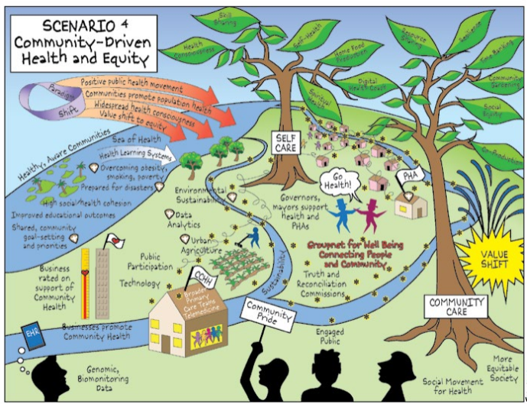
Become a Chief Health Strategist
Focus on demographics/needs of community
Use evidence-based approaches
Use up-to-date & granular data
Partner with health care
Partner with other sectors, too
Find and get to the table

Slide 8
The 3 Buckets of Prevention
Traditional Clinical Prevention
Innovative Clinical Prevention
Community-Wide Prevention
1
2
3
Increase the use of clinical preventive services
Provide services that extend care outside the clinical setting
Implement interventions that reach whole populations
Health Care
Public Health
Notes:
Buckets of prevention offer of framework for addressing community needs and identifying strategies. Those working with public health have to consider a wide variety of approaches to promote the public’s health. Public health needs to attend to all these buckets, but one or the other may be more appropriate depending on the situation. This can be confusing particularly as we enter discussions with other sectors whose understanding of the term “preventive care” and “population health” may be different than our own. I will come back to this concept later in the presentation as we delve deeper into the remaining CHS practices.

Slide 9
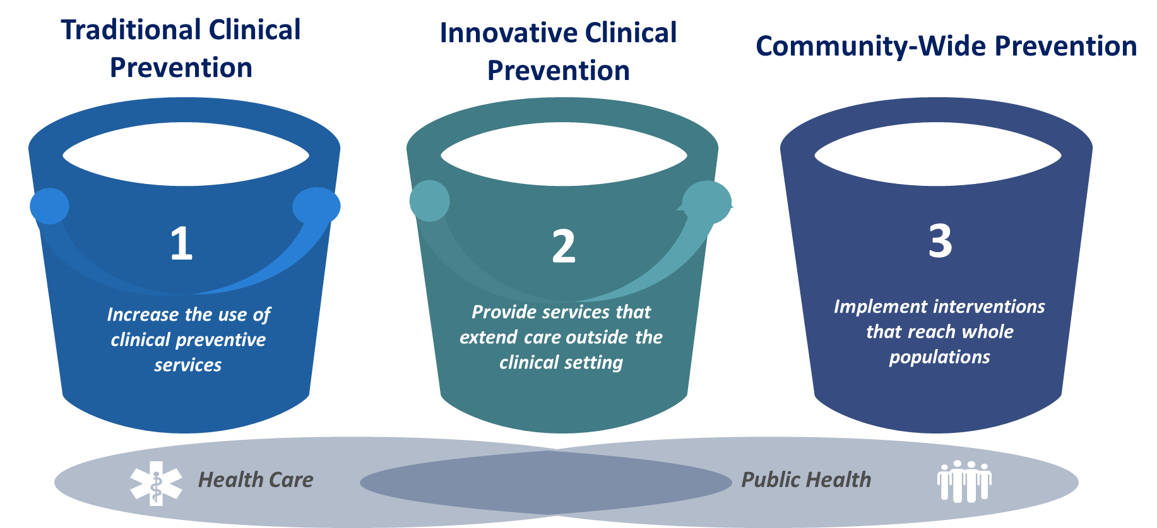
Bucket 1: Traditional Clinical Approaches
Focus on Preventive Care

Slide 10
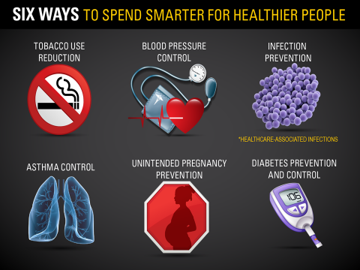
Development of 6|18 Initiative
Focus on 6 high-cost, high-prevalence conditions
Review of CIO evidence-based clinical interventions
18 interventions identified

Slide 11
Bucket 2: Innovative Patient-Centered Care
Focus on Preventive Care

Slide 12
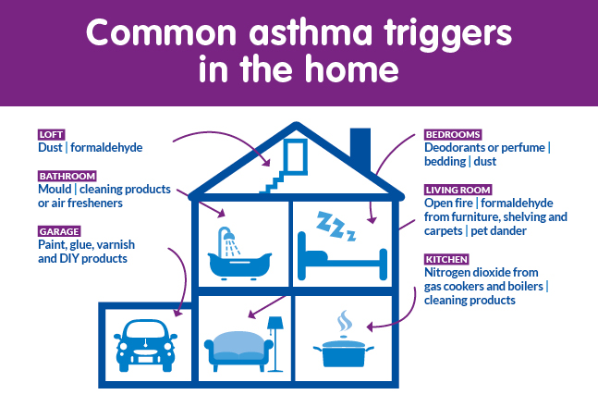
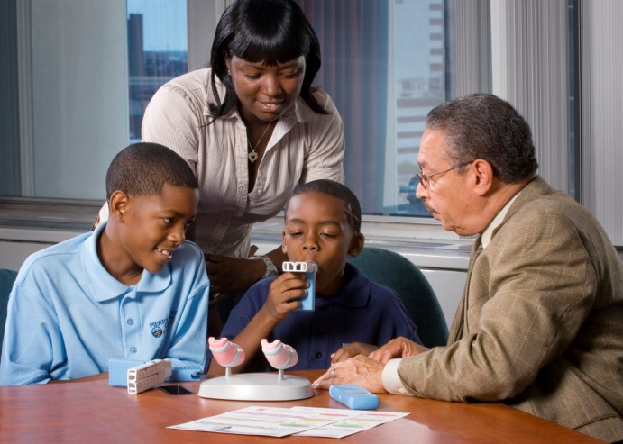
To Address Asthma:
Healthy Home Risk Reduction
Home visit by CHWs to
  Provide additional education/ encouragement
  Assess risk factors in the home
  Assist in removing risk factors
Notes:
State Example:
Massachusetts’ broad-based policies, consistent and powerful advocacy from the CHW workforce, and partnership with state public health partners secured the ongoing integration of CHWs into health care systems .

Slide 13
Bucket 3: Community-Wide Health
Focus on Preventive Care

Slide 14
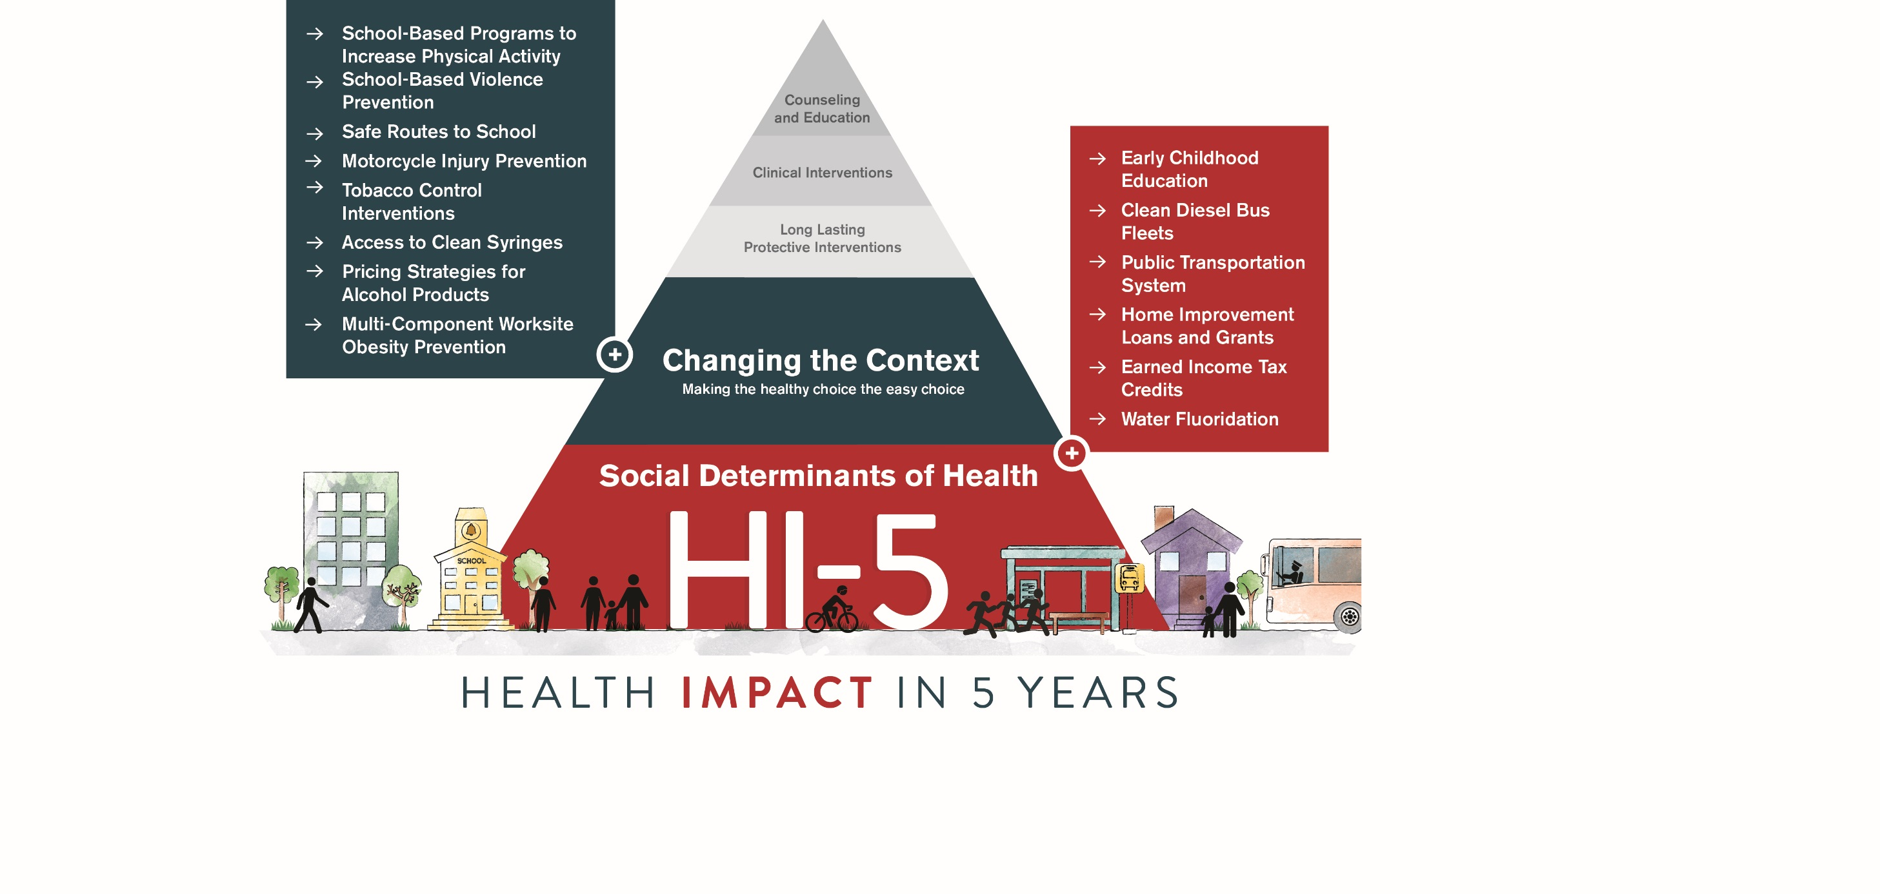

Slide 15

A Few Caveats
There are many other worthwhile efforts
  Some take longer to work
  Some don’t save money
  Some haven’t been evaluated

Slide 16
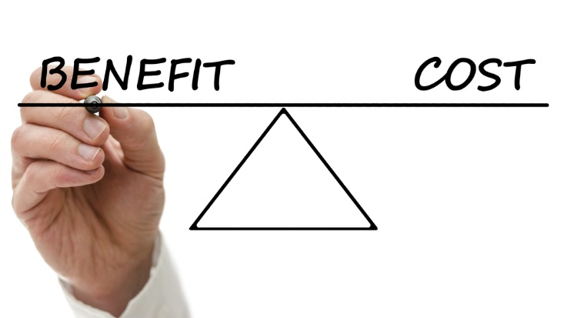

What Makes The HI-5 List Different?
  HEALTH: Improves health and well-being in as early as 5 years
  COST: Cost effectiveness and/or savings over the lifetime of the population or earlier

Slide 17
14 Evidence-Based, Community-Wide Interventions
Address the Social Determinants of Health
Early Childhood Education
Clean Diesel Bus Fleets
Public Transportation System Introduction or Expansion
Home Improvement Loans and Grants
Earned Income Tax Credits
Water Fluoridation
Make Healthy Choice Easy Choice
School/Physical Activity Programs
School/Violence Prevention
Safe Routes to School
Motorcycle Injury Prevention
Tobacco Control Interventions
Access to Clean Syringes
Pricing Strategies: Alcohol
Worksite Obesity Prevention

Slide 18

Tobacco Control Interventions
Description
  Tobacco price increases
  High-impact mass media campaigns
  Comprehensive smoke-free policies
Health Impact
  Reduced hospitalizations for asthma/heart attacks
  Reduced youth who start/Increased quitting in youth/adults
Economic Impact
  Smoke-free indoor policies: hospital admits down by 5-20%
  Mass-media campaigns: benefit-to-cost ratio up to 74:1
  Raise prices 20%: savings up to $90 per person per year

Slide 19

Early Childhood Education (ECE)
Description
  Teach literacy, emotional & motor skills to kids 3-4 years
  Offer recreation, meals, health care, social services
  Most benefit for children in poverty
Health Impact
  Improved cognitive & emotional development
  Healthier weight
  Reduced maltreatment
  Protective against adult disease & disability
Economic Impact
  Benefit-cost ratios ranging from 3:1 to 5:1

Slide 20
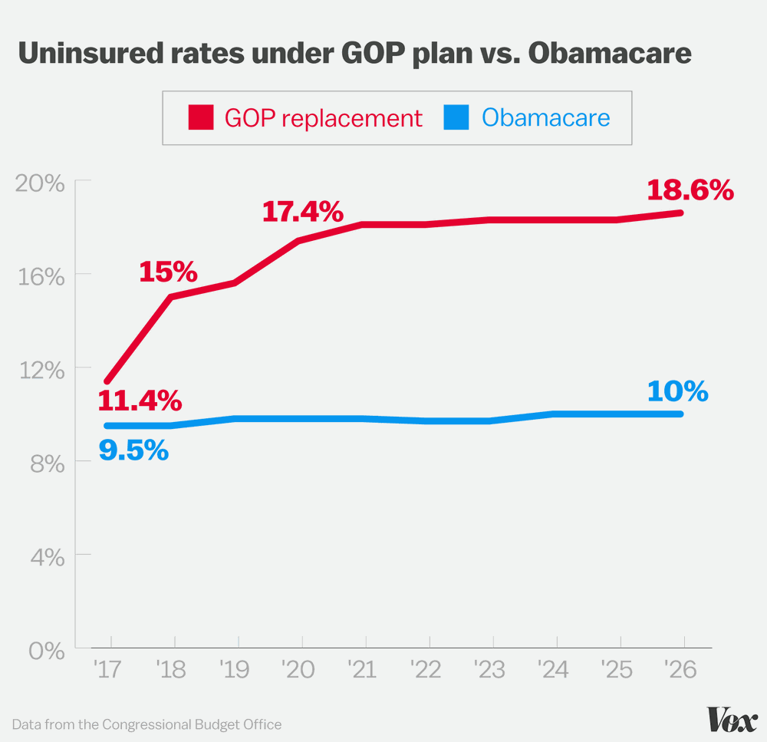
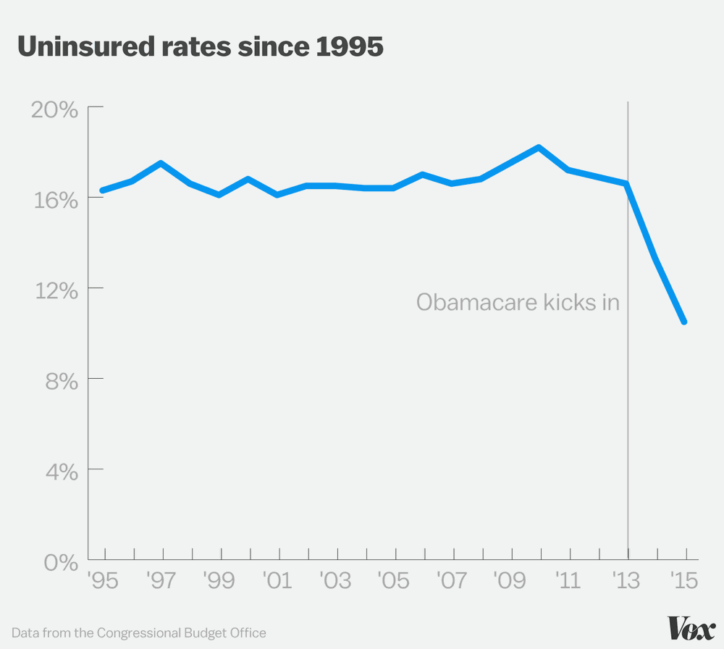
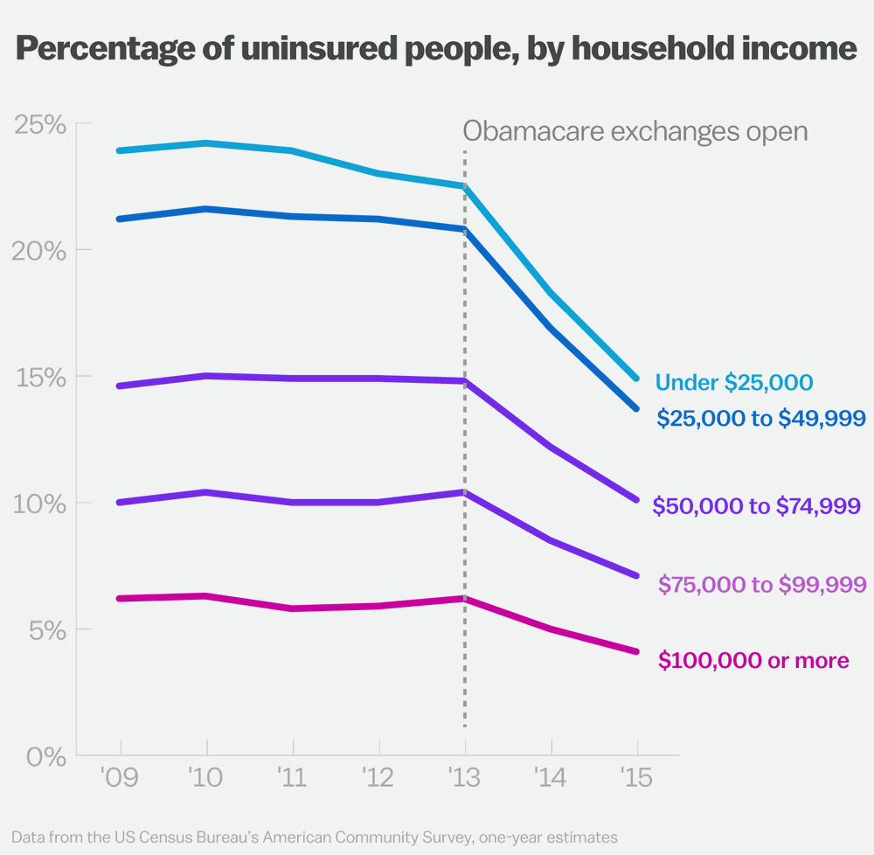
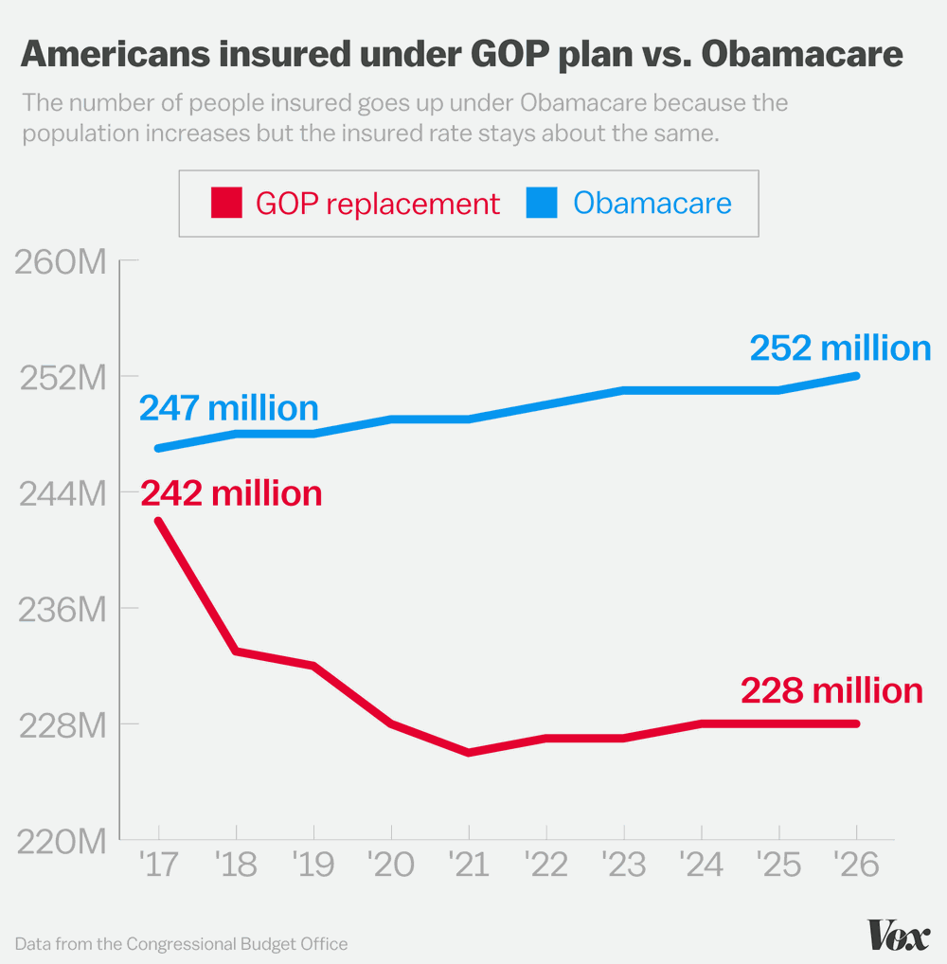
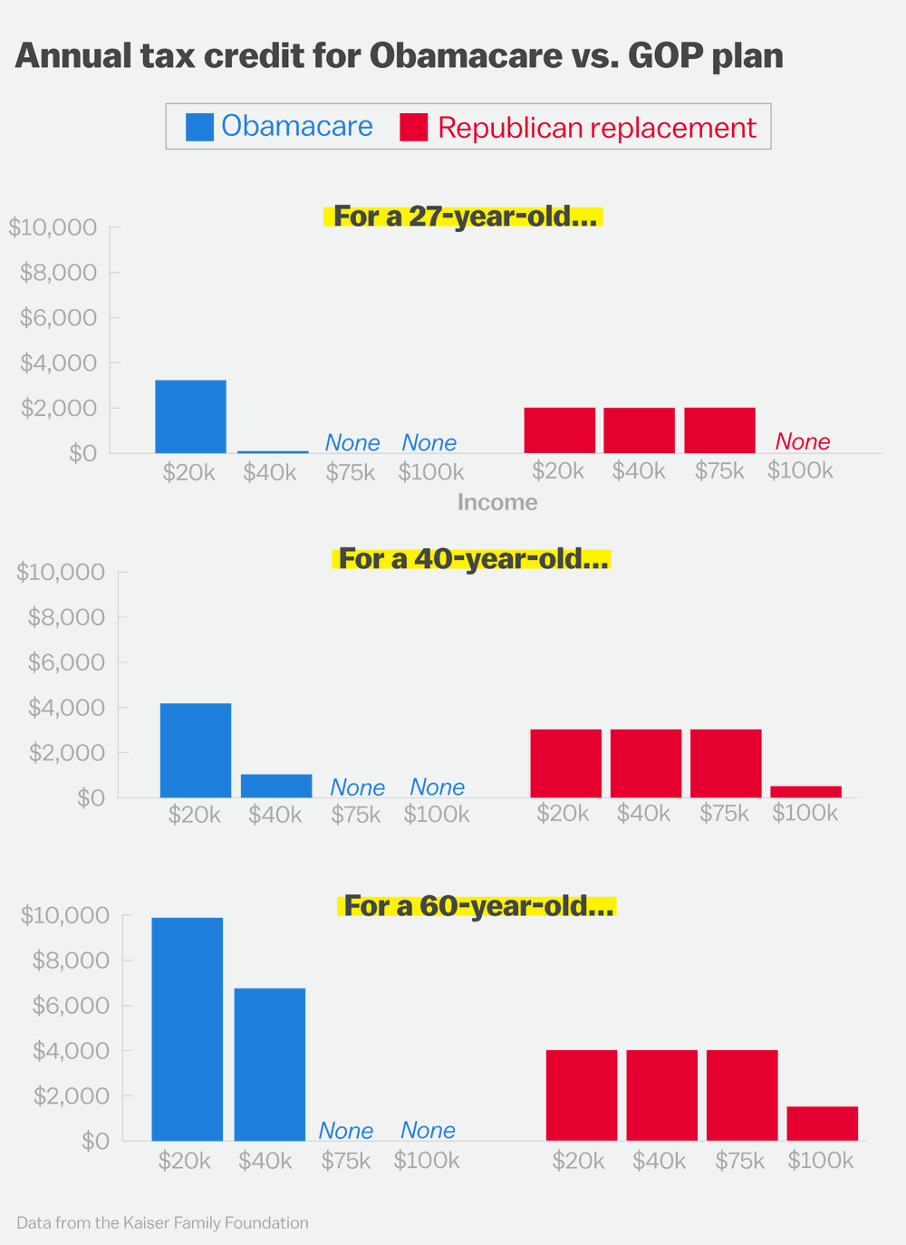
24 Million Could Lose Insurance

Slide 21
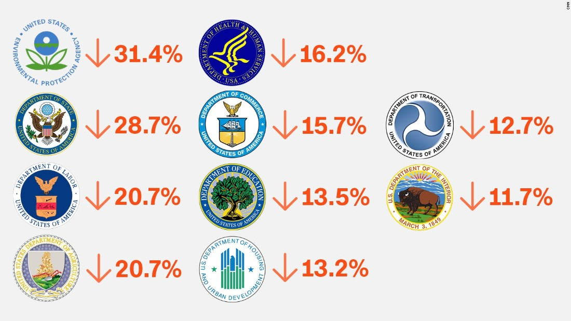
Proposed Federal Cuts in Many Agencies That Affect Health

Slide 22
Our Response: Protect the Prevention and
Public Health Fund
The Need
The Response
  12% of CDC’s funding - $890,000,000
  Most of it goes to states and cities
  Core public health
  Develop state-specific materials/campaigns
  Educational sessions with Congress
  Multiple materials developed
  http://www.tfah.org/health-issues/pphf/

Slide 23
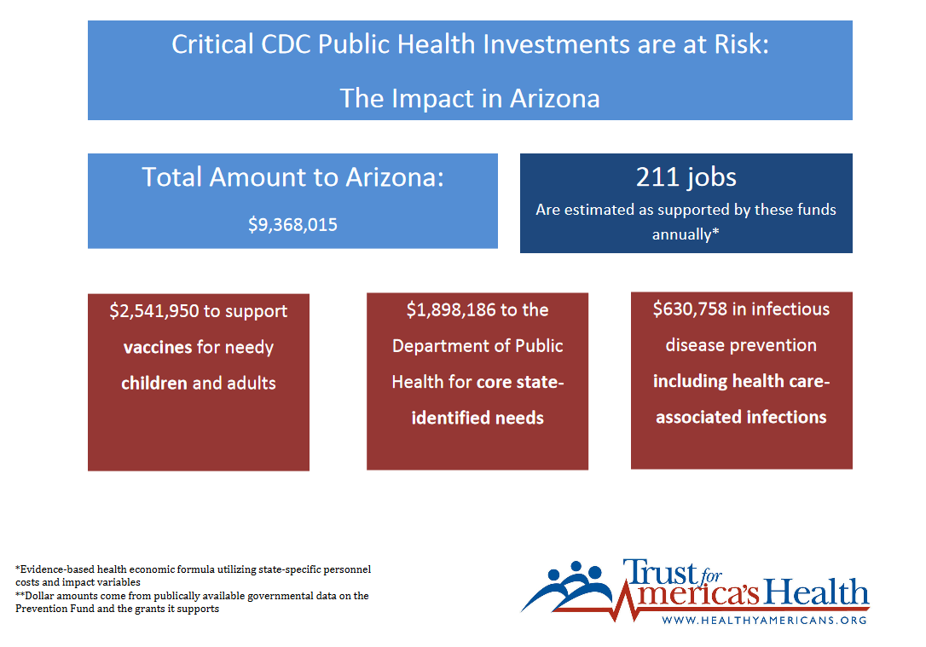

Slide 24
Our Response: Fight for Resources at the
State, Local, Tribal and Territorial Levels
The Need
The Response
President proposes 18% cut in HHS
FY17 still unresolved and proposed cuts
Zika money runs out
Slow response to emergencies
New Report: www.tfah.org/report/136/
“A Funding Crisis for Public Health and Safety: State-by-State Public Health Funding”
Protect federal funding
Support new emergency fund

Slide 25
To see what’s at stake:
Healthy Communities Navigator
A dynamic searchable interactive platform that provides stakeholders with state, county, and community population health resources, including:
  a range of federal and private grants,
  stories; and
  models of best practices and policy tools
http://healthyamericans.org/healthycommunities/#/navigator/grantee
Notes:
Healthy Communities Navigator: In order to continue to build an effective case and multi-sector partnerships for community prevention, TFAH recently developed and launched our Healthy Communities Navigator: Cross-sector Grants, Success Stories and Policy Papers. The navigator is a dynamic searchable interactive platform that provides stakeholders with state, county, and community population health resources, including a range of federal and private grants, stories and models of best practices and policy tools to support the continued development of work in this area. TFAH’s goal is to ensure stakeholders can better link and integrate a range of community prevention efforts in a given state/community.

Slide 26
Our Response: Protect Access to Free
Prevention Services
The Need
The Response
New publication: www.tfah.org/report/135/
“Impact of 2017 Health Reform Proposals on Clinical Preventive Services”
Build broad coalition
Educate Congress/staff
Create of non-partisan forum
ACA replacement doesn’t guarantee free prevention services
Barriers to care will increase illness/injury

Slide 27
Her Needs Are the Same…
Are they less likely to be met?
Primary care & meds - more costly premium?
Asthma home visits – defunded?
Diabetes Prevention - defunded?
Behavioral services – no required coverage?
Neighborhood safety - defunded?
Affordable, healthy foods – less CDC funding?
Mold removal – less HUD funding?

Slide 28
She Needs Our Help

