Slide 1
The Passive Path to Physical Activity
AzPHA & Az Forward Stewardship Summit
Bob England, MD, MPH April 26, 2017

Slide 2
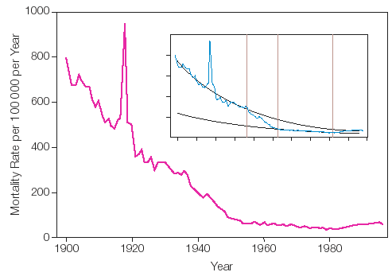
Trends in Infectious Disease Mortality in the United States During the 20th Century
Armstrong, GL. JAMA. 1999 Jan 6;281(1):61-6.
Notes:
2

Slide 3
Obesity Trends* Among U.S. Adults BRFSS, 1985
(*BMI ≥30, or ~ 30 lbs overweight for 5’ 4” person)
No Data <10% 10%–14%

Slide 4
Obesity Trends* Among U.S. Adults BRFSS, 1986
(*BMI ≥30, or ~ 30 lbs overweight for 5’ 4” person)
No Data <10% 10%–14%

Slide 5
Obesity Trends* Among U.S. Adults BRFSS, 1987
(*BMI ≥30, or ~ 30 lbs overweight for 5’ 4” person)
No Data <10% 10%–14%

Slide 6
Obesity Trends* Among U.S. Adults BRFSS, 1988
(*BMI ≥30, or ~ 30 lbs overweight for 5’ 4” person)
No Data <10% 10%–14%

Slide 7
Obesity Trends* Among U.S. Adults BRFSS, 1989
(*BMI ≥30, or ~ 30 lbs overweight for 5’ 4” person)
No Data <10% 10%–14%

Slide 8
Obesity Trends* Among U.S. Adults BRFSS, 1990
(*BMI ≥30, or ~ 30 lbs overweight for 5’ 4” person)
No Data <10% 10%–14%

Slide 9
Obesity Trends* Among U.S. Adults BRFSS, 1991
(*BMI ≥30, or ~ 30 lbs overweight for 5’ 4” person)
No Data <10% 10%–14% 15%–19%

Slide 10
Obesity Trends* Among U.S. Adults BRFSS, 1992
(*BMI ≥30, or ~ 30 lbs overweight for 5’ 4” person)
No Data <10% 10%–14% 15%–19%

Slide 11
Obesity Trends* Among U.S. Adults BRFSS, 1993
(*BMI ≥30, or ~ 30 lbs overweight for 5’ 4” person)
No Data <10% 10%–14% 15%–19%

Slide 12
Obesity Trends* Among U.S. Adults BRFSS, 1994
(*BMI ≥30, or ~ 30 lbs overweight for 5’ 4” person)
No Data <10% 10%–14% 15%–19%

Slide 13
Obesity Trends* Among U.S. Adults BRFSS, 1995
(*BMI ≥30, or ~ 30 lbs overweight for 5’ 4” person)
No Data <10% 10%–14% 15%–19%

Slide 14
Obesity Trends* Among U.S. Adults BRFSS, 1996
(*BMI ≥30, or ~ 30 lbs overweight for 5’ 4” person)
No Data <10% 10%–14% 15%–19%

Slide 15
Obesity Trends* Among U.S. Adults BRFSS, 1997
(*BMI ≥30, or ~ 30 lbs overweight for 5’ 4” person)
No Data <10% 10%–14% 15%–19% ≥20%

Slide 16
Obesity Trends* Among U.S. Adults BRFSS, 1998
(*BMI ≥30, or ~ 30 lbs overweight for 5’ 4” person)
No Data <10% 10%–14% 15%–19% ≥20%

Slide 17
Obesity Trends* Among U.S. Adults BRFSS, 1999
(*BMI ≥30, or ~ 30 lbs overweight for 5’ 4” person)
No Data <10% 10%–14% 15%–19% ≥20%

Slide 18
Obesity Trends* Among U.S. Adults BRFSS, 2000
(*BMI ≥30, or ~ 30 lbs overweight for 5’ 4” person)
No Data <10% 10%–14% 15%–19% ≥20%

Slide 19
Obesity Trends* Among U.S. Adults BRFSS, 2001
(*BMI ≥30, or ~ 30 lbs overweight for 5’ 4” person)
No Data <10% 10%–14% 15%–19% 20%–24% ≥25%

Slide 20
Obesity Trends* Among U.S. Adults BRFSS, 2002
(*BMI ≥30, or ~ 30 lbs overweight for 5’ 4” person)
No Data <10% 10%–14% 15%–19% 20%–24% ≥25%

Slide 21
Obesity Trends* Among U.S. Adults BRFSS, 2003
(*BMI ≥30, or ~ 30 lbs overweight for 5’ 4” person)
No Data <10% 10%–14% 15%–19% 20%–24% ≥25%

Slide 22
Obesity Trends* Among U.S. Adults BRFSS, 2004
(*BMI ≥30, or ~ 30 lbs overweight for 5’ 4” person)
No Data <10% 10%–14% 15%–19% 20%–24% ≥25%
Notes:
We have never had an epidemic like this that we have been able to track so thoroughly and see. As I told you, this is conservative.
About 60 million adults, or 30 percent of the adult population, are now obese, which represents a doubling of the rate since 1980.

Slide 23
Obesity Trends* Among U.S. Adults BRFSS, 2005
(*BMI ≥30, or ~ 30 lbs overweight for 5’ 4” person)
No Data <10% 10%–14% 15%–19% 20%–24% 25%–29% ≥30%
Notes:
We have never had an epidemic like this that we have been able to track so thoroughly and see. As I told you, this is conservative.
About 60 million adults, or 30 percent of the adult population, are now obese, which represents a doubling of the rate since 1980.

Slide 24
Obesity Trends* Among U.S. Adults BRFSS, 2006
(*BMI ≥30, or ~ 30 lbs. overweight for 5’ 4” person)
No Data <10% 10%–14% 15%–19% 20%–24% 25%–29% ≥30%

Slide 25
Obesity Trends* Among U.S. Adults BRFSS, 2007
(*BMI ≥30, or ~ 30 lbs. overweight for 5’ 4” person)
No Data <10% 10%–14% 15%–19% 20%–24% 25%–29% ≥30%

Slide 26
Obesity Trends* Among U.S. Adults BRFSS, 2008
(*BMI ≥30, or ~ 30 lbs. overweight for 5’ 4” person)
No Data <10% 10%–14% 15%–19% 20%–24% 25%–29% ≥30%

Slide 27
Obesity Trends* Among U.S. Adults BRFSS, 2009
(*BMI ≥30, or ~ 30 lbs. overweight for 5’ 4” person)
No Data <10% 10%–14% 15%–19% 20%–24% 25%–29% ≥30%

Slide 28
Obesity Trends* Among U.S. Adults BRFSS, 2010
(*BMI ≥30, or ~ 30 lbs. overweight for 5’ 4” person)
No Data <10% 10%–14% 15%–19% 20%–24% 25%–29% ≥30%

Slide 29
So what if we’re fat?
Hypertension
High blood cholesterol
Metabolic disorder
Diabetes
Coronary heart disease
Congestive heart failure
Stroke
Gallstones
Cholescystitis & cholelithiasis
Gout
Osteoarthritis
Obstructive sleep apnea and respiratory problems
Some types of cancer (e.g., endometrial, breast, prostate, and colon)
Complications of pregnancy (DM, HTN, preeclampsia, c-sections)
Menstrual irregularities, infertility, irregular ovulation
Bladder control problems (such as stress incontinence)
Uric acid nephrolithiasis
Psychological disorders (e.g., depression, eating disorders, distorted body image, and low self-esteem)

Slide 30
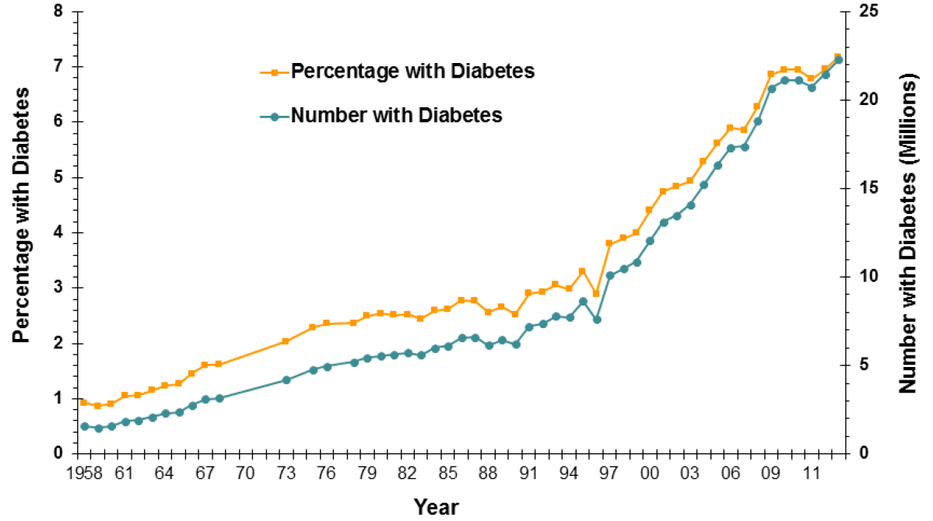
Number and percentage of US pop with diagnosed Diabetes

Slide 31
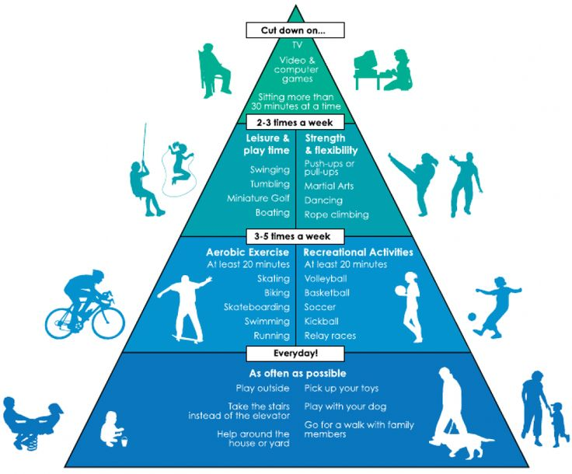

Slide 32
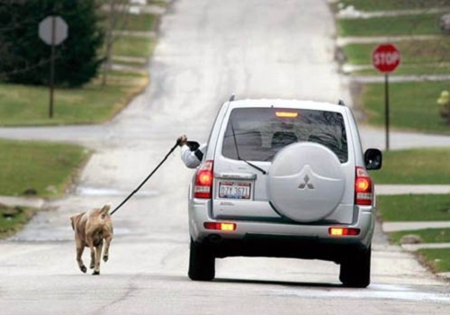

Slide 33
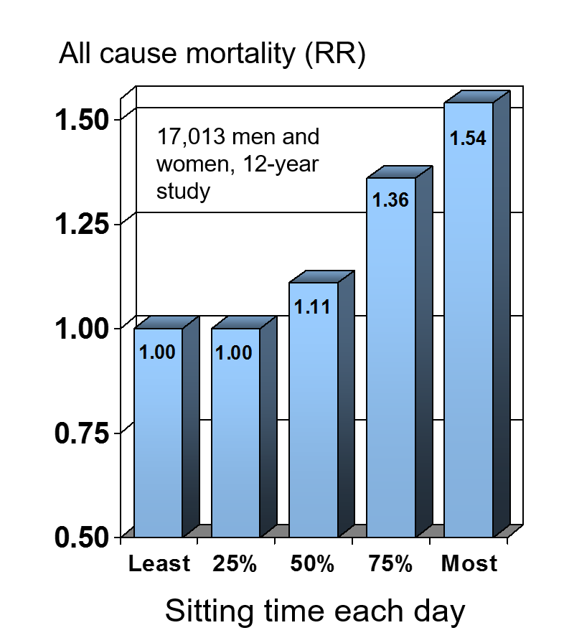
Sitting Kills
Researchers found a strong association with daily sitting time and risk of mortality.
Medicine & Science in Sports & Exercise 2009 May;41:998-1005

Slide 34
Trends in Infectious Disease Mortality in the United States During the 20th Century
Armstrong, GL. JAMA. 1999 Jan 6;281(1):61-6.
Notes:
34

Slide 35
Penicillin
Armstrong, GL. JAMA. 1999 Jan 6;281(1):61-6.
Notes:
35

Slide 36
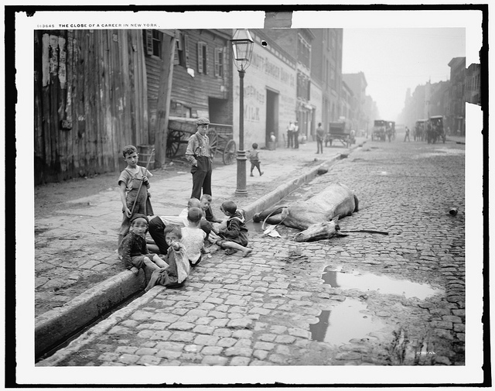

Slide 37
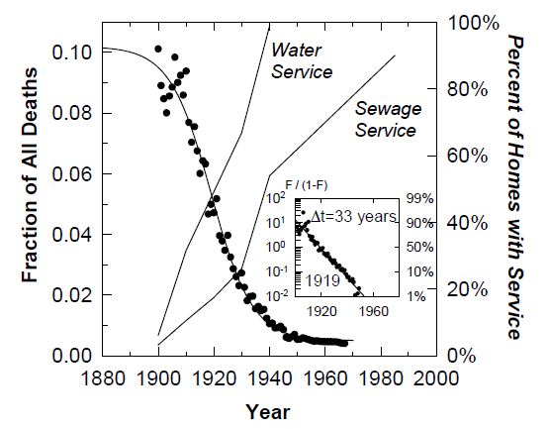
Deaths from Aquatically Transmitted Diseases as a Fraction of All Deaths: U.S. 1900-1967

Slide 38
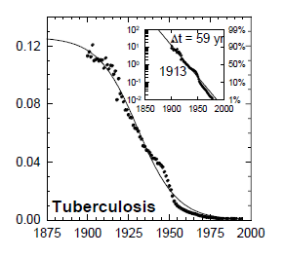
Tuberculosis, All Forms, as a Fraction of All Deaths: U.S. 1900-1997
Drugs

Slide 39
Public Health Successes of the 19th & 20th Centuries
How much individual ed?
How much personal effort?
How much health care?
Environmental, communal, passive

Slide 40
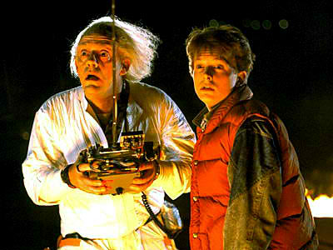

Slide 41


