Slide 1
Transportation initiatives at Maricopa County Department of Public Health
Liza Oz-Golden, AICP

Slide 2
Active Transportation Plans (ATPs)
Maricopa County Department of Transportation (MCDOT)
Maricopa Association of Governments (MAG)

Slide 3
Active Transportation Plans (ATPs) Maricopa County Department of Transportation (MCDOT)
Data
Outreach
Technical Advisory Committee (TAC)

Slide 4
Active Transportation Plans (ATPs) Maricopa Association of Governments (MAG)
Consultant selection process
Application review
Input throughout the planning process

Slide 5
Maricopa Association of Governments Active Transportation Plan
“The consultant will frame the vision, goals and objectives through the lens of a healthy, happy region for all… while also examining the American Public Health Association ten principles of equity for transportation – focusing on the social connection of people through placemaking, and planning facilities that improve public health, happiness, safety, accessibility and equity.”
RFP MAG, FY 2017 MAG Regional Active Transportation Plan

Slide 6
Active Transportation Plans (ATPs) Maricopa Association of Governments (MAG)
Consultant selection process
Application review
Input throughout the planning process

Slide 7
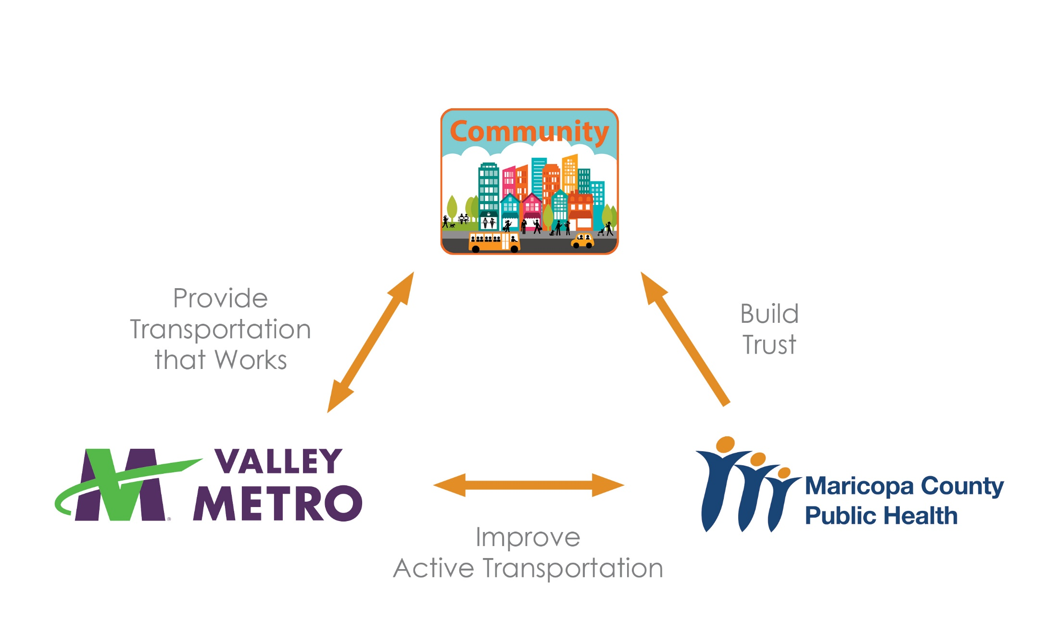
Community Engagement
Regional Bus Stop Survey – Valley Metro

Slide 8
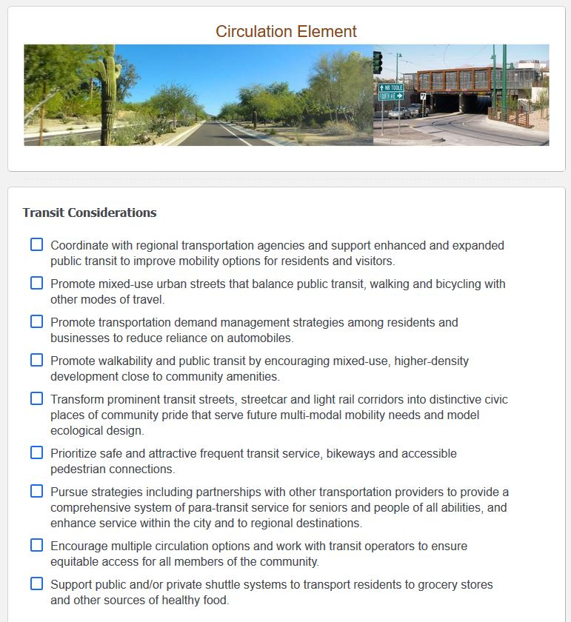
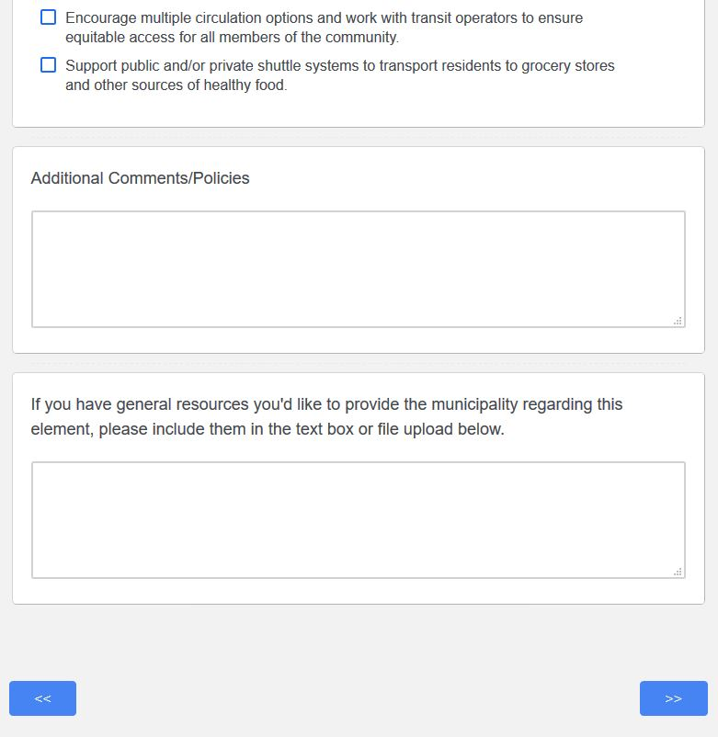
Healthy Community Design Policy ToolKit

Slide 9
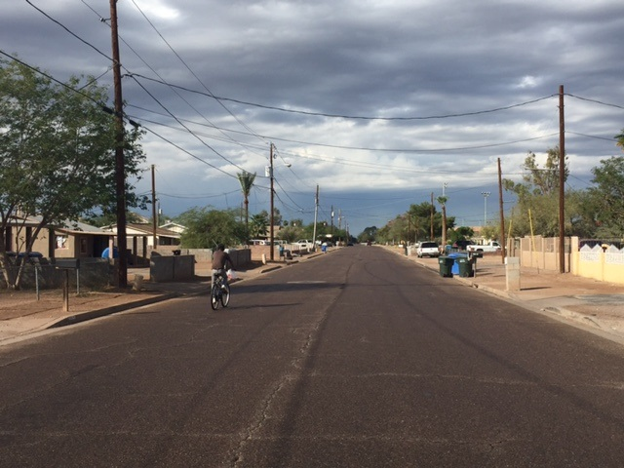
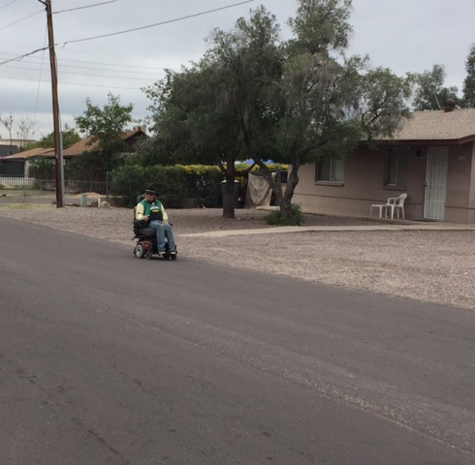
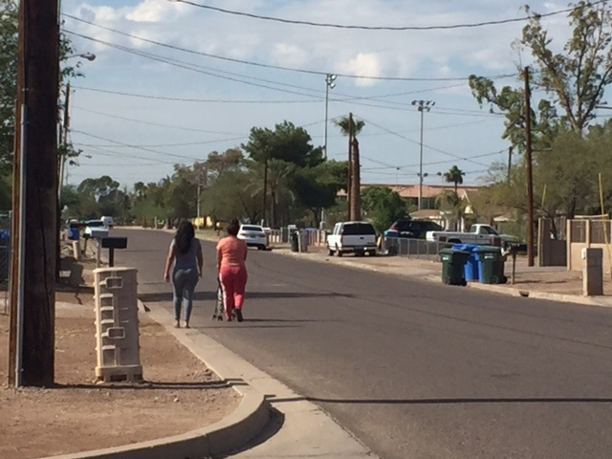
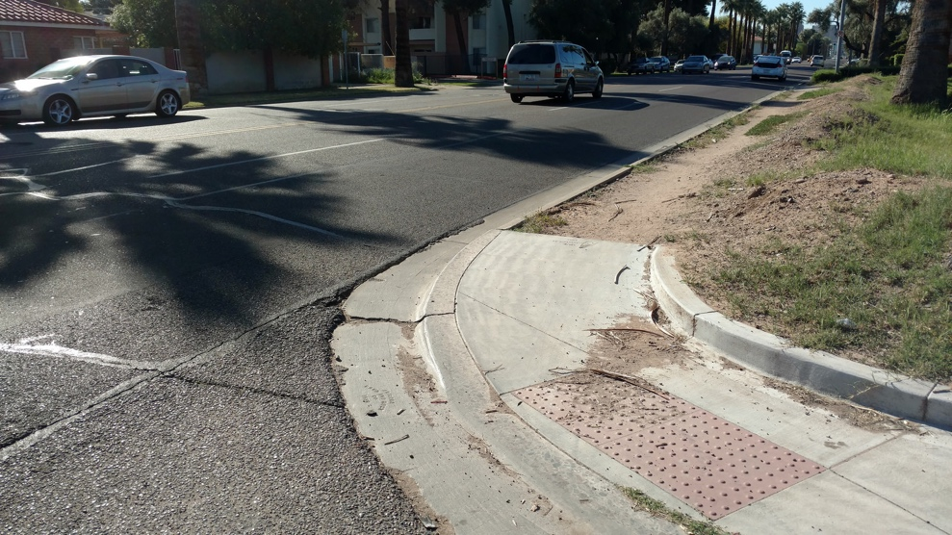
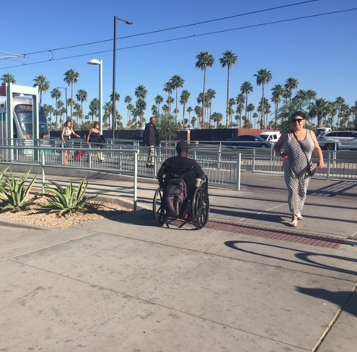
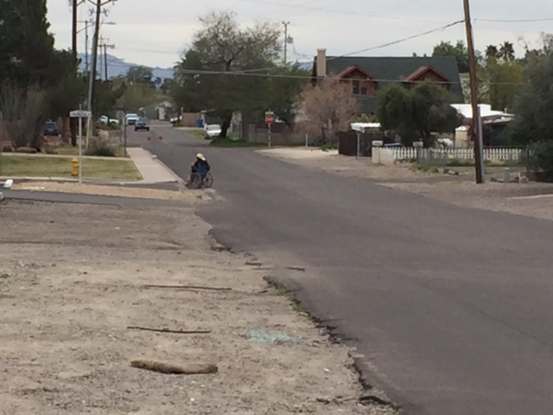

Slide 10
Contact me at
Liza Oz-Golden, AICP
lizagolden@mail.Maricopa.gov
(602) 506-9335

