Slide 1

What Does What I Do Have to Do with Health?

Slide 2


Slide 3
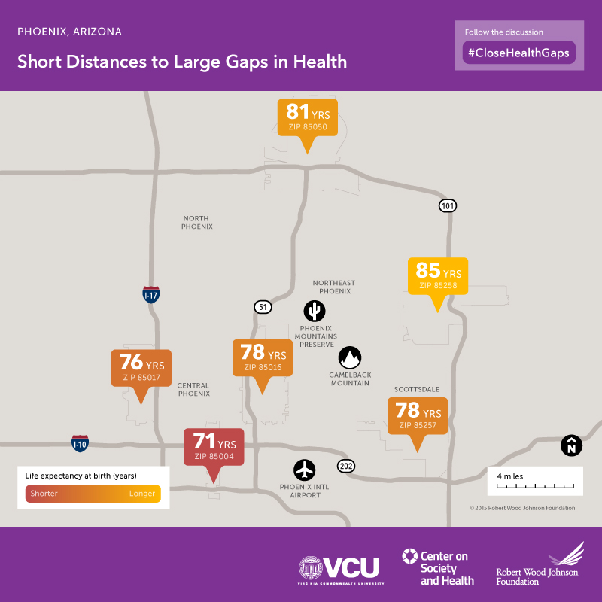

Slide 4
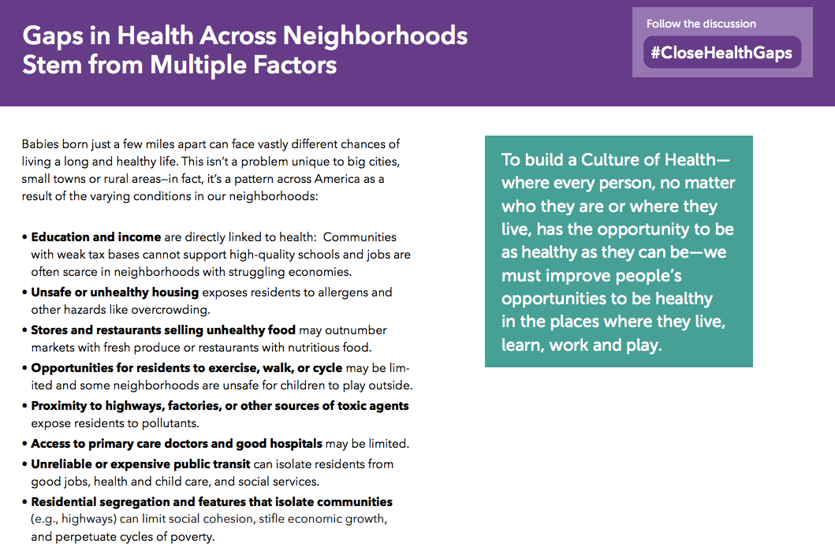

Slide 5
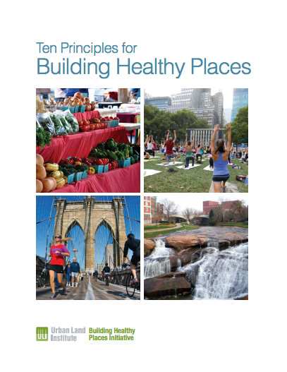
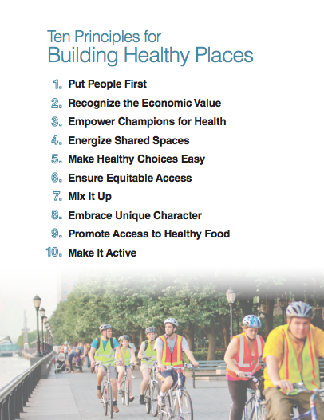

Slide 6
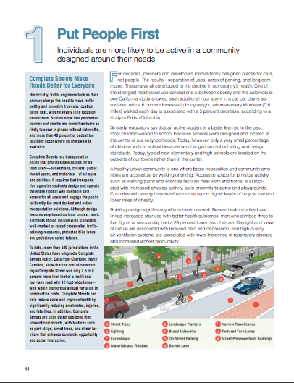
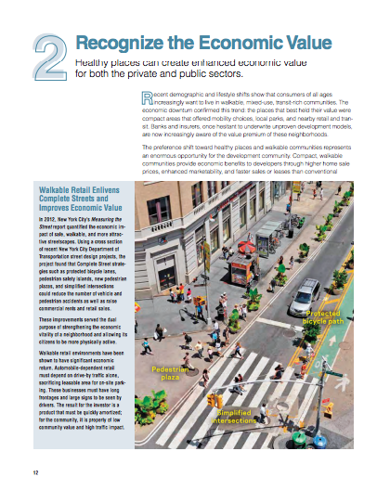

Slide 7
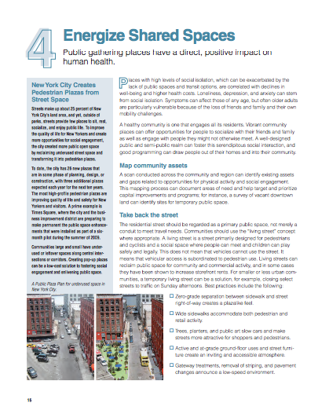

Slide 8
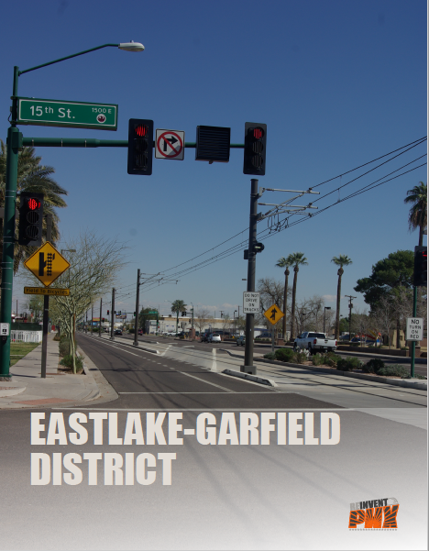
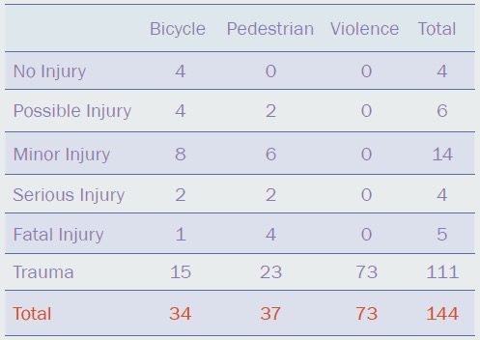

Slide 9
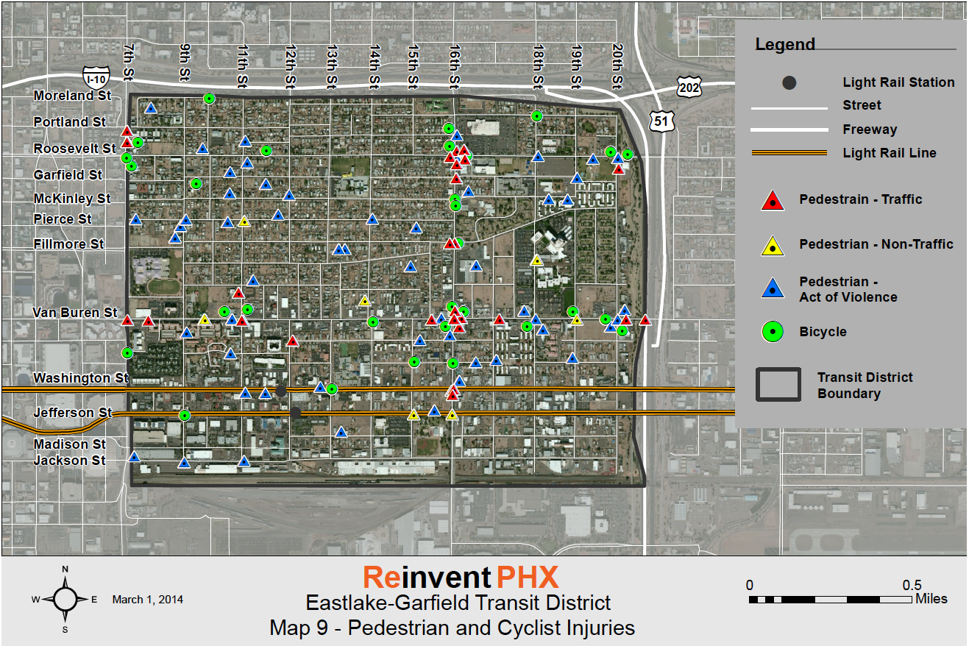

Slide 10
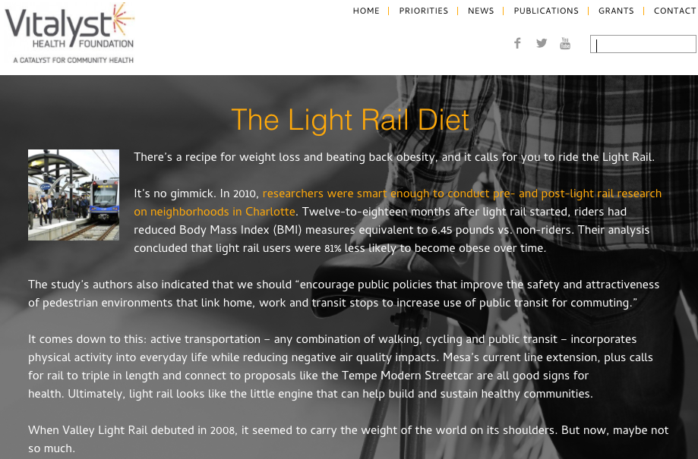
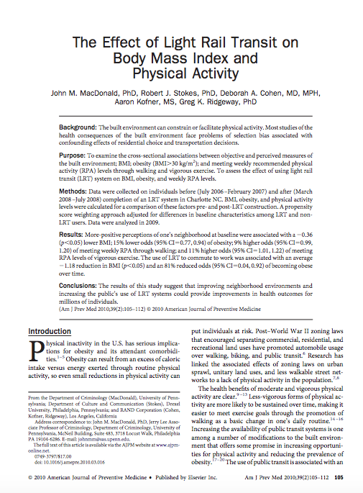

Slide 11
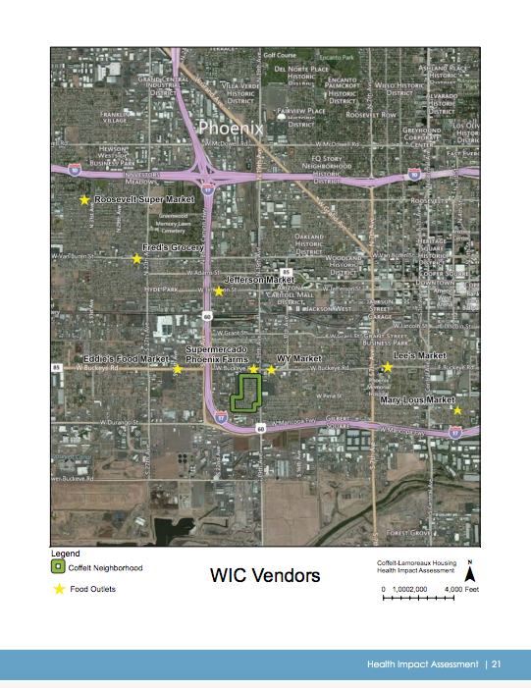
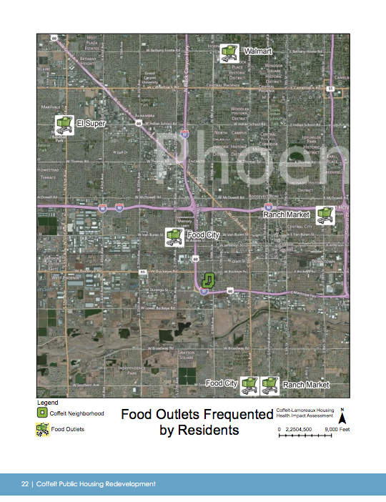

Slide 12
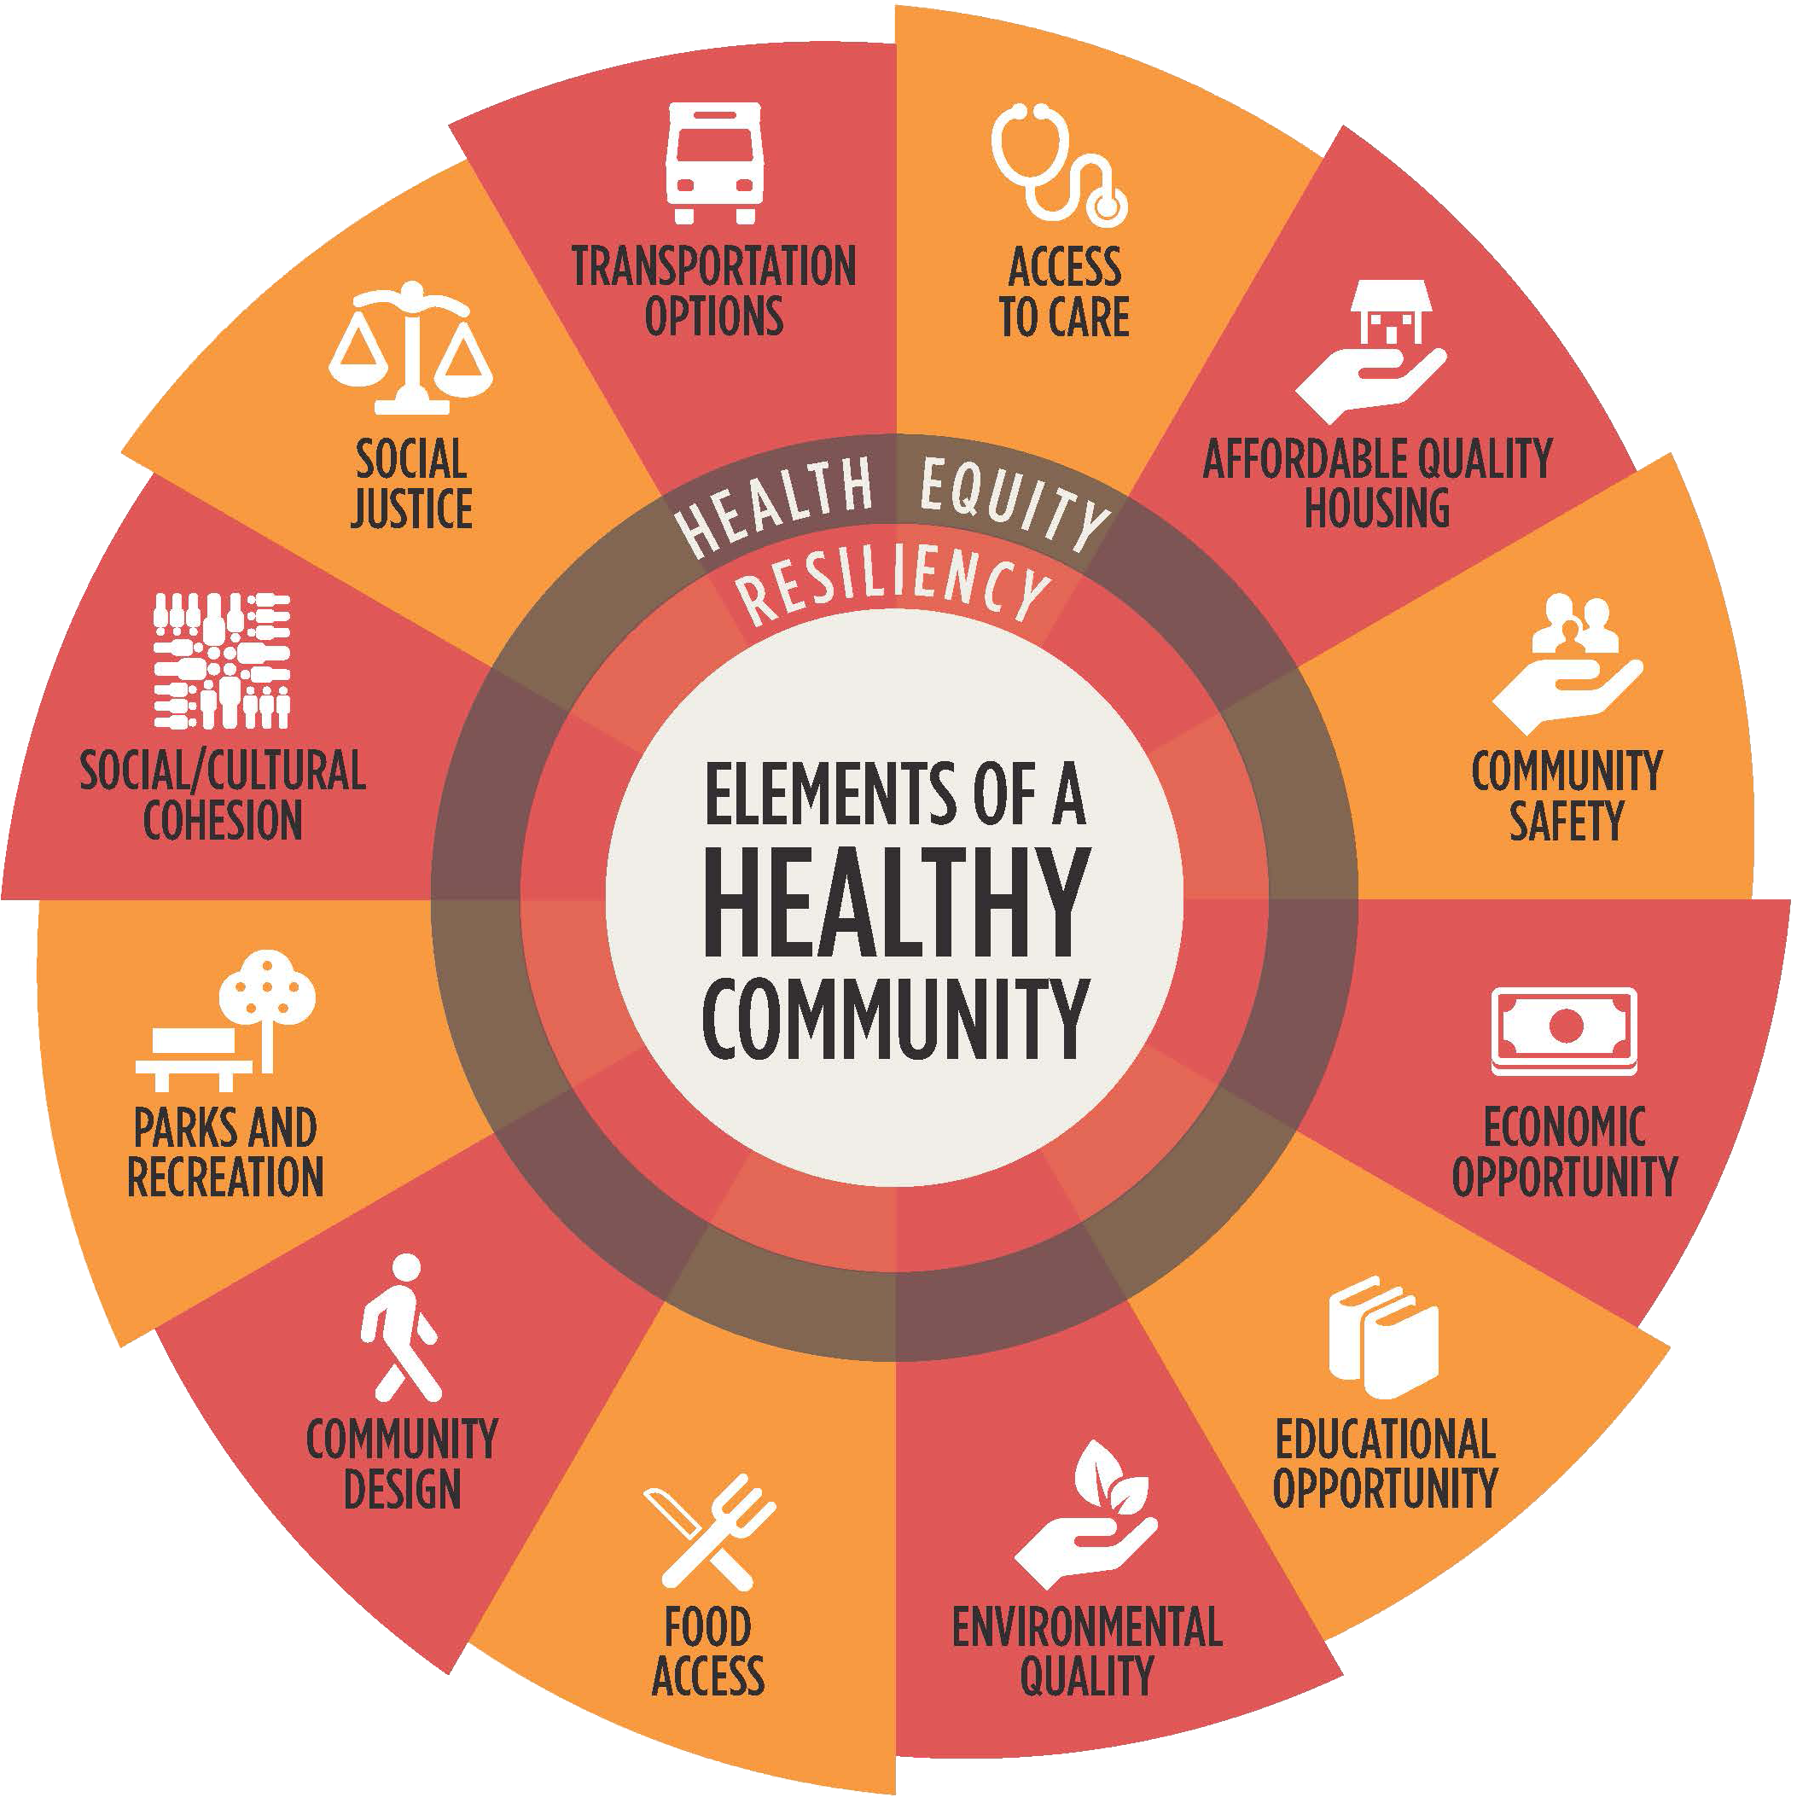

Slide 13
Goals
Identify, lift up and celebrate efforts to help Arizonans be healthier and live well
Facilitate connections between groups and sectors
Shift the “health” paradigm – health is more than health care.
Influence policies and systems for change

Slide 14
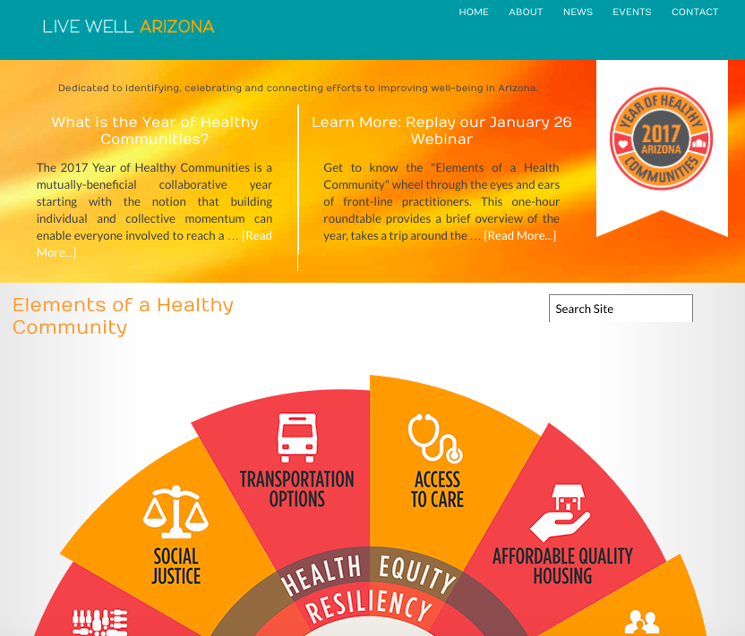

Slide 15




January 26 Webinar
Marcus Johnson Vitalyst Health Foundation
Diana Yazzie Devine Native American Connections
Michael McDonald Community Food Bank of Southern Arizona
Emily Yetman Living Streets Alliance

Slide 16
March 14 Webinar
Matt Eckhoff
Rio Rico Medical & Fire District
Zach Johnson Gorman & Company
Kate Radosevic Local First Arizona
Mark Melnychenko City of Phoenix

Slide 17
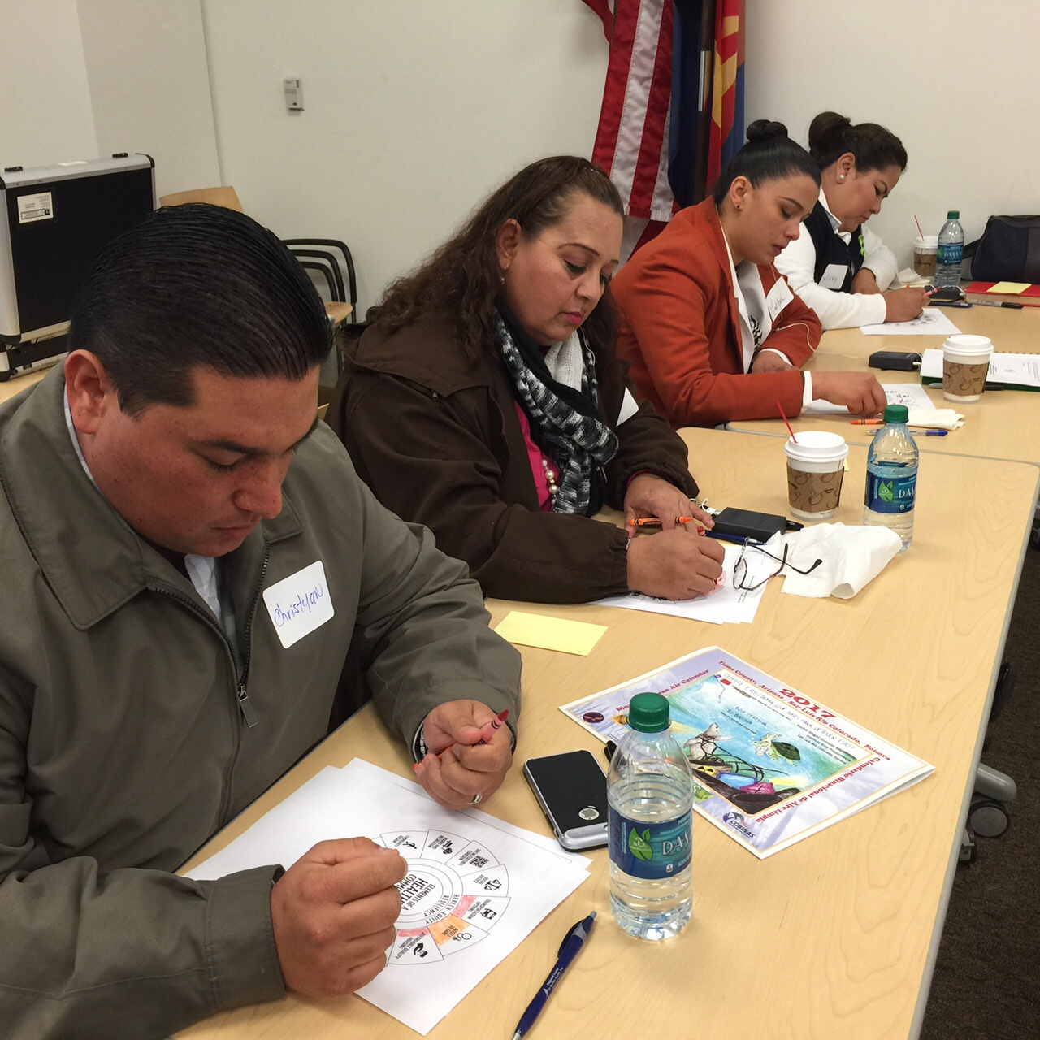
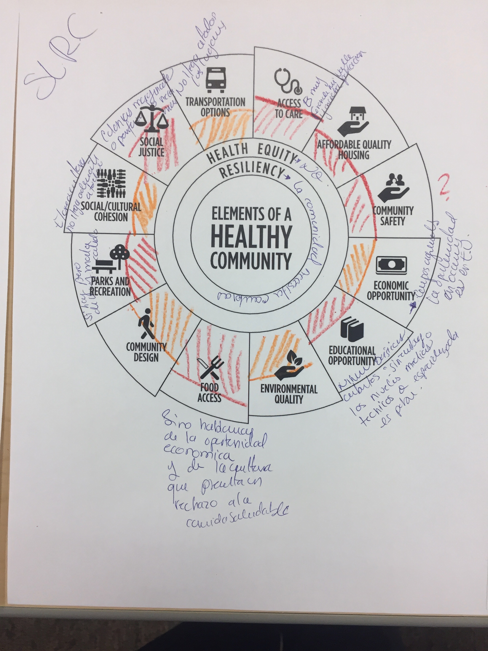
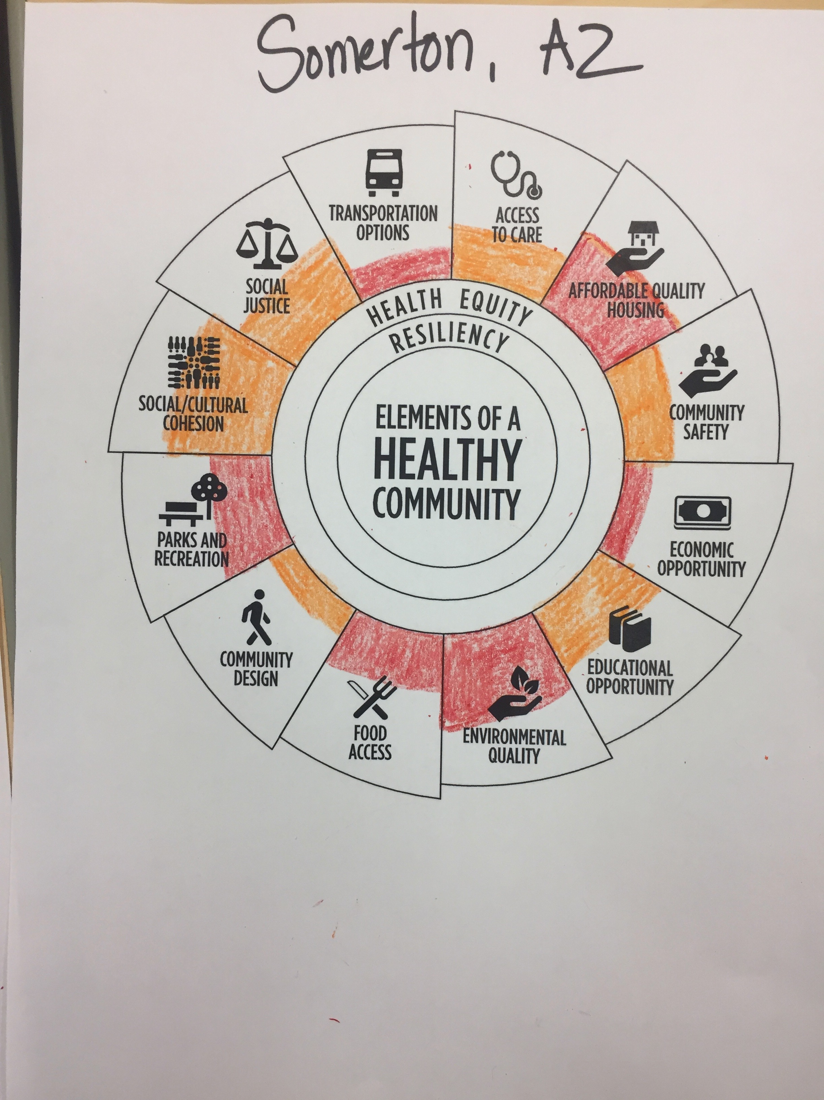
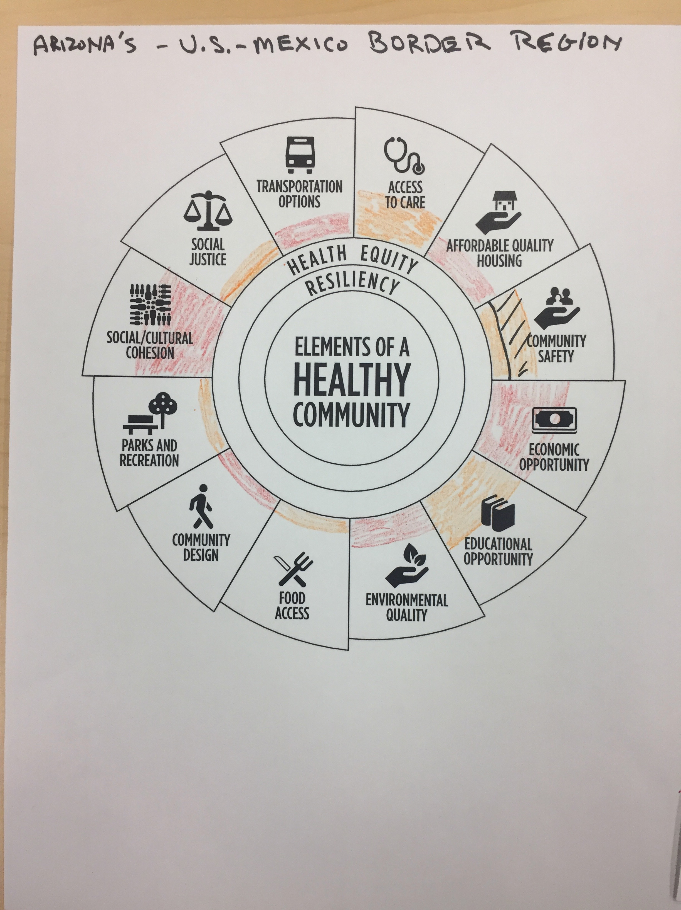
Coloring the Wheel

Slide 18
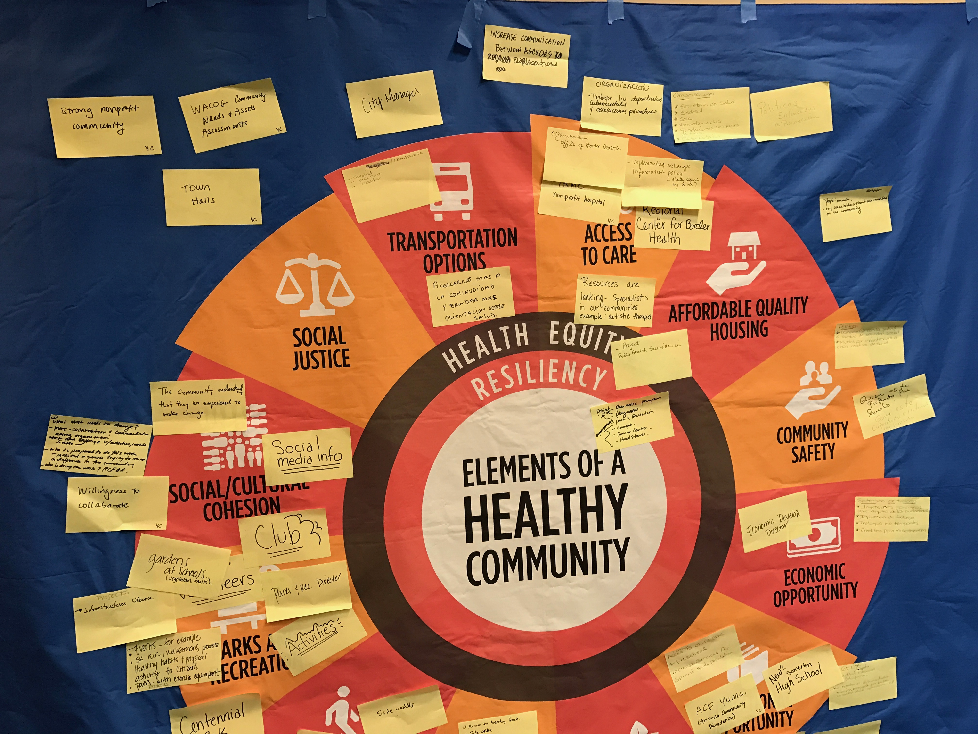
Yuma Workshop

Slide 19
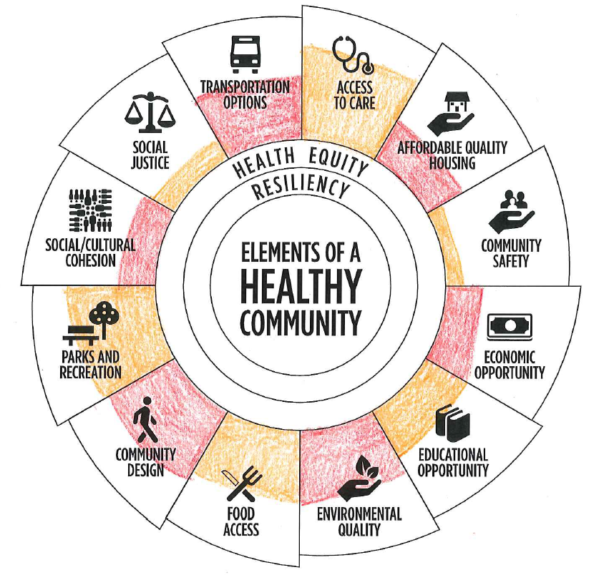
What Are The Colors of Your Work?
Pick a place
Assess how each element of the wheel contributes
Color in the element to the extent you assess your place is strong in that aspect

Slide 20
What We’ve Heard…
Access/Proximity
Equity
Creativity
Infrastructure, economic and social aspects
Walk the talk
Put people in the center

Slide 21
Our Collective Call to Action
Get comfortable with being uncomfortable.
Engage: make new friends and listen.
Learn in order to grow.
Digg into what’s happening with the people you’ve met today.
Embrace the mess the ensues, and help work through it – always with the outcomes we seek at the fore

Slide 22
Our Collective Call to Action
Get comfortable with being uncomfortable.
Where the Magic Happens
Comfort
Zone

Slide 23
Our Collective Call to Action
Get comfortable with being uncomfortable.
Engage: make new friends and listen.

Slide 24
Our Collective Call to Action
Get comfortable with being uncomfortable.
Engage: make new friends and listen.
Learn in order to grow.

Slide 25
Our Collective Call to Action
Get comfortable with being uncomfortable.
Engage: make new friends and listen.
Learn in order to grow.
Digg into what’s happening with the people you’ve met today.

Slide 26
Our Collective Call to Action
Embrace the mess the ensues.
Help work through it – always with the outcomes of well-being at the fore

Slide 27




May 16 Webinar
Connor Descheemaker Local First Arizona
Paul Luna Helios Education Foundation
Emily Jenkins Arizona Council of Human Service Providers
Michael Soto Equality Arizona

Slide 28
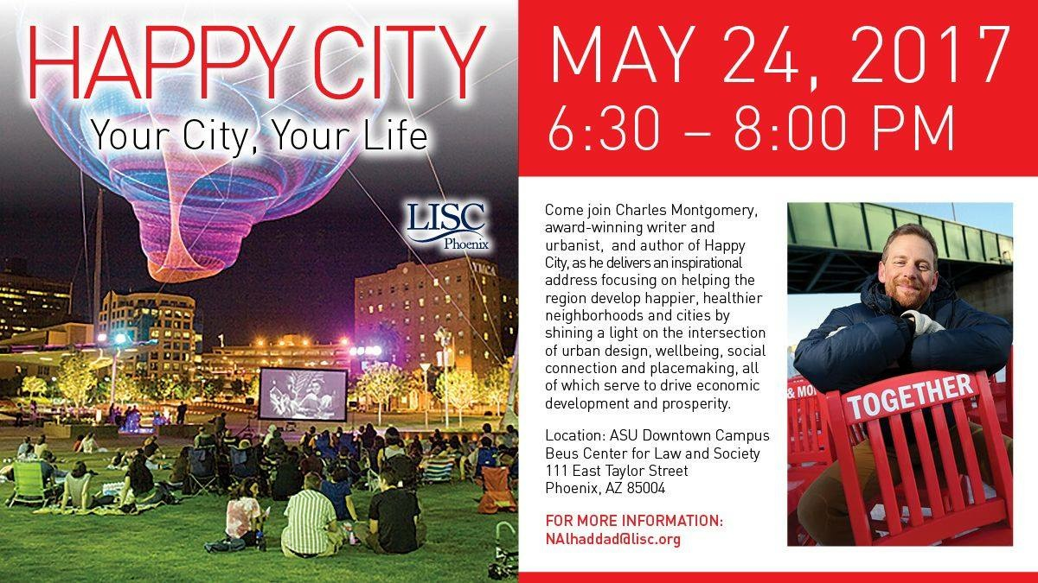

Slide 30
LiveWellAZ.org
VitalystHealth.org

